Slide 1
D School Team - Mental Health and Wellness - Siembra Bienestar
Maribel: Parent and Community Member
Maria: CHI
Rosanna: Parent and Cope Volunteer
Sarahi: First 5
Danielle: Cope Family Center
Multilingual!
Notes:
Our team focussed on mental health, and consists of

Slide 2
Our Project: Crux of the Matter
“We need to figure out how we can deliver and normalize mental health and wellness services during and after a disaster that are non-traditional, responsive to individual comfort and long lasting resilience building”
Notes:
The thing we were trying to figure out was

Slide 3
What we Have Learned
Key insights we learned from interviews
Parent’s mental health affects their children’s, but they don’t always prioritize it
Movement and art are ways that families bond and reduce stress
Parents get information and support from people they know and trust
A sense of community is important and helps parents build relationships, learn about resources from one another and help each other out
Notes:
We started out by interviewing 5 parents of children 0-5 years old, 4 woman and one man, all were Latino 2 interviews were in spanish, two in english. about their experiences with mental health, especially during disasters

Slide 4
The Question Became...
How do we help parents of color that have children 0-5 yo with their mental health during disasters:
More specifically...
How might we help parents realize that their mental health affects their kids, and that resources are available for them not just for their kids?
Notes:
After reflecting on the interviews we really latched onto the idea of helping parents focus in on their own mental health and the question became

Slide 5
What if we...
Start a Parent/Child Informal Soccer Team
Parents in Codesign session liked this idea - told stories of times families had gathered to play Soccer and exchanged support.
Inclusive: Everyone knows how to play Soccer!
Create Parent and Child “Mental Health/Wellness Kits”
Idea came about after Codesign session
Help parents have a moment to catch their breath during disasters

Slide 6
The Prototype Process: Let’s test it out on ourselves first!
We decided to do a mock “soccer game” between members of our group and we each made a “mental health kit” to share with the group before we decided on the final kit.
The soccer meetup went well, we saw that as our Codesign guest had suggested, it helped us to establish relationships, stay connected within the community, and could be used as a way to introduce already established resources and help in Napa County.
There was a child and parent that was at the park and the child joined in on the soccer game, which indicates that community events can attract other families and help engage the community.
Notes:
Opted to focus in on the mental health kits as the pandemic continues to be everchanging and effect individual’s comfort with gathering

Slide 7
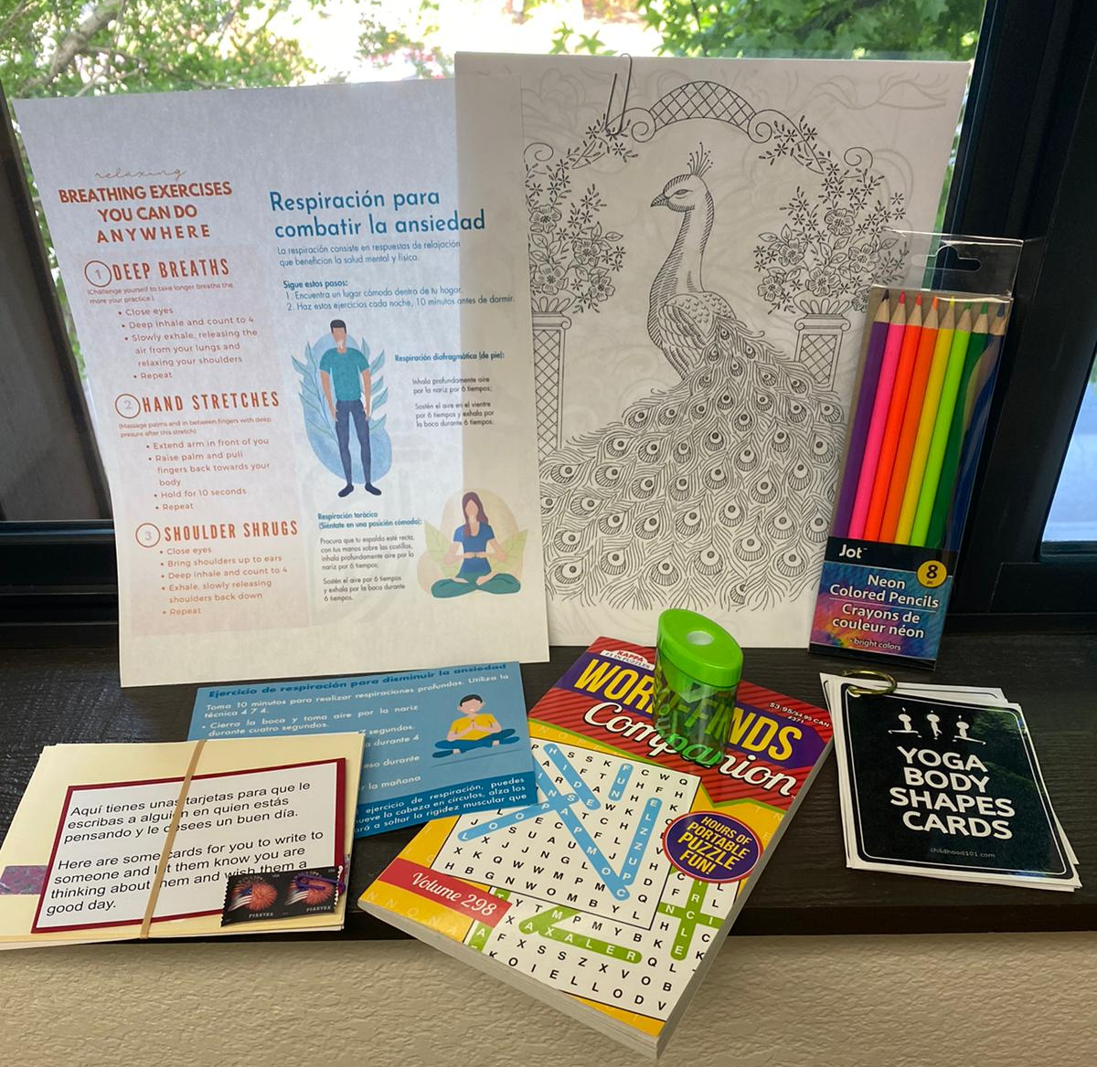
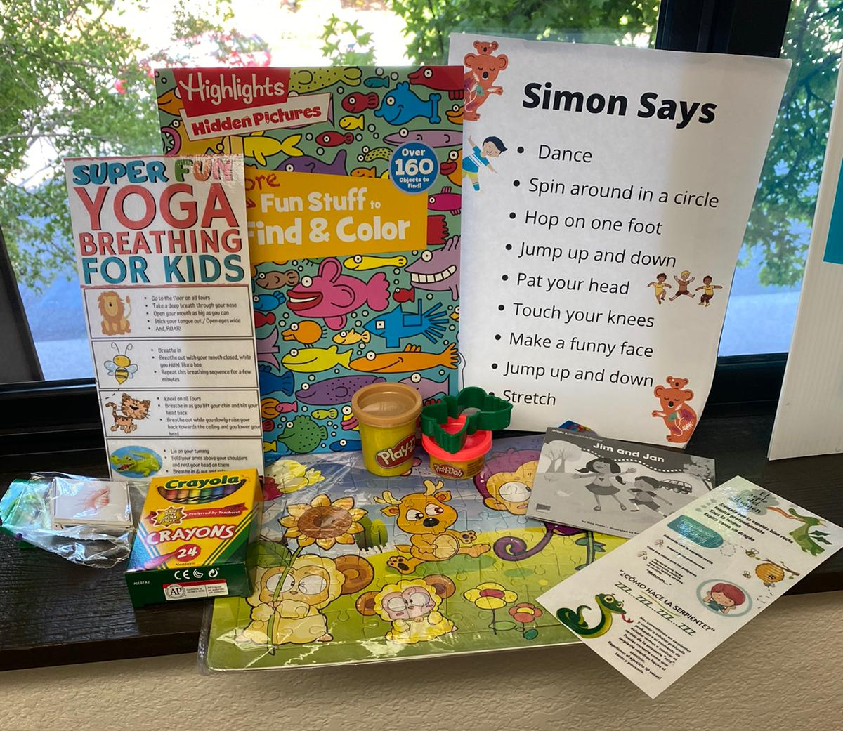
The Prototype
Based on our first meetup, we came together to create our final “Mental Health Kit” and ended up making 2 kits. One for adults and one for kids.
The kits consisted of elements to help parents tend to their mental health needs in a stressful moment. As well as items to occupy children and help create parent/child connection
After we decided on and built a “final” prototype, we decided to send these to 4 of the parents we interviewed and asked for their feedback via a survey that we included in the kits when we delivered them.

Slide 8
Feedback from Parents
All were excited to receive the kits
Yoga body shape cards were a frequent favorite which surprised us!
One child shared the kit with other children in their apartment complex, creating more connection
One parent shared that the kits helped keep their children occupied while they focussed on dealing with the pandemic
A parent shared that they’d like more guidance in kits on what to do in disasters and how to talk to children about the experience - we can add this!

Slide 9
Next Steps
Understanding the other key stakeholders. Coordinate with other local organizations who might have similar endeavors:
Napa County Public Library - Handed out kits at beginning of pandemic - mid-year 2020
COAD Mental Health Committee - might also be creating kits
First 5 Rainbow League - ongoing project and currently recruiting on social media
Boys & Girls Club - start conversation with them to create activity for kids to make some of the elements for the kits - handmade cards, assembling quick reference cards , etc
Investigate and determine who should receive next round of kits:
PG&E: with the next planned power-outage, get kits to some of households affected
Napa Library partnership to distribute kits and include books
NEWS Shelter: reach out to Tracy and Sarah at NEWS for families at the shelters to receive the kits
Cope and Napa Fair Housing: Identify some families that might be in stressful situations that would benefit from receiving a kit
Produce and Distribute small round of kits
Produce and distribute~20 kits along with a feedback loop back to us.

Slide 10
Equipo 7 - Salud Mental de Napa CA
Nuestro proceso para nuestro prototipo es el siguiente:
1. Decidimos hacer un "juego de fútbol" simulado entre los miembros de nuestro grupo y cada miembro hizo un "kit de salud mental" simulado para compartir con el grupo antes de decidir el kit final.
a. un. La reunión de fútbol fue bien, vimos que, como lo había sugerido nuestro invitado en co-diseño, esta ayuda para comenzar a establecer relaciones, nos ayudó a mantenernos conectados dentro de la comunidad y se usaría como una forma de presentar recursos y ayuda ya establecidos en el condado de Napa.
b. Había un niño y un padre que estaba en el parque y quería unirse al partido de fútbol, lo que indica que el evento comunitario puede atraer a otros padres y ayudar a involucrar a la comunidad.
2. A continuación, nos unimos para crear nuestro “kit de salud mental” final, y terminamos haciendo 2 kits. Uno es para adultos durante un momento estresante y el segundo es para niños. Los kits consistieron en elementos útiles que se utilizaron para ayudar a los padres a tener un momento de paz y atender sus necesidades de salud mental en un momento estresante.
3. Después de que decidimos y construimos un prototipo “final”, decidimos enviarlos a 4 de los padres que entrevistamos y les pedimos sus comentarios a través de una encuesta que incluimos en los kits cuando los entregamos.

