Slide 1
Welcome!
¡Bienvenidos!

Slide 2
If you need tech help, please message Heidi Merchen directly in the chat.
Si necesitas ayuda técnica, envíe un mensaje a Heidi Merchen directamente
en el chat.

Slide 3
We would like to begin today by acknowledging that we gather as Live
Healthy Napa County on the ancestral and unceded territory of the
Patwin, Onosatis, Miwok and Pomo Peoples past and present, and honor with gratitude the land itself and the people who have stewarded it
throughout the generations.
Queremos comenzar hoy reconociendo que nos reunimos como Vive
Saludable Condado de Napa en el Territorio ancestral e incesante de los
pueblos Patwin, Onosatis, Miwok y Pomo pasados ​​y presentes, y honrar
con gratitud a la tierra misma y a las personas que la han administrado a
lo largo de las generaciones.

Slide 4
Hi Friends/Hola Amigos
Who is here today? ¿Quién está hoy aquí?
Please enter your name in the chat. If you are here
representing an organization, please enter that as well.
Ingrese su nombre en el chat. Si usted representa a una
organización, por favor ingrese el nombre.
Notes:
For Spanish Interpretation:
In your meeting/webinar controls, click Interpretation
Click the language that you would like to hear. We will track questions in the chat and reach out with any answers that we can’t answer immediately

Slide 5
Hi Friends/Hola Amigos
What sector are you from? ¿Cuál sector representa?
Please choose your sector from the options in the poll.
Elija su sector entre las opciones de la encuesta.

Slide 6
Hi Friends/Hola Amigos
How are you feeling today?¿Cómo se siente hoy?
Please click the link in the chat to access Mentimeter and
answer the question there.
Haga clic en el enlace del chat para acceder a Mentimeter y
responda la pregunta allí.

Slide 7
Para español:
1. En los controles de su reunión / seminario web, haga clic en
Interpretación.
2. Haga clic en el idioma que le gustaría escuchar.
3. (Opcional) Para escuchar solo el idioma interpretado, haga clic en
Silenciar audio original.

Slide 8
Agenda
Review of 2019-2020 work/ Revisar el trabajo de 2019-20
Review 4 Community Health Action Plan Projects/ Revisar los 4 proyectos del Plan de acción de Salud Comunitaria
Break into groups to discuss project changes/ Formar grupos para discutir los cambios del proyecto.
Close &Survey link/ Finalizar & enlace de encuesta

Slide 9
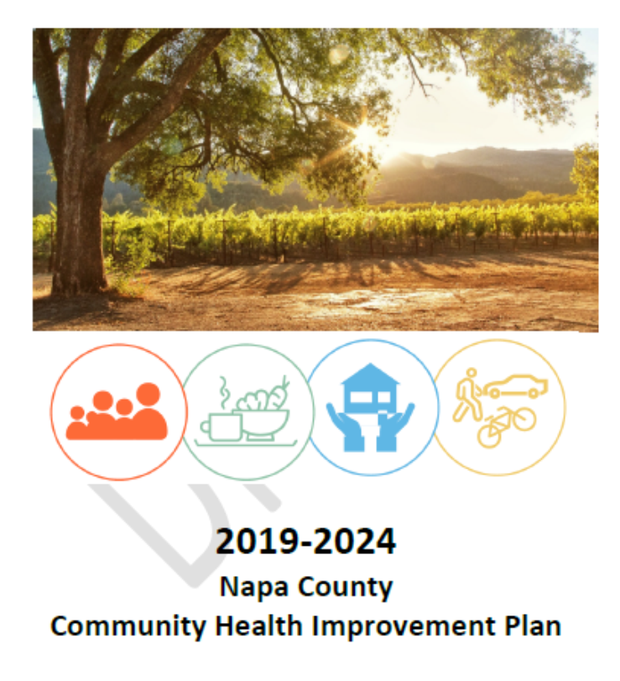
CHIP Update
PRIORITY AREAS:
Respect & Social Inclusion
Food Insecurity
Housing
Transportation

Slide 10
CHIP Update
AREAS PRIORITARIAS:
Respeto e Inclusión Social
Inseguridad alimentaria
Vivienda
Transporte

Slide 11
Human-Centered Design
Discover the opportunity
Empathize
Ideate
Define
Prototype
Test
Understand
people deeply
Experiment your
way forward

Slide 12
Diseño centrado en el ser humano
Descubra la oportunidad
Empatizar
Idear
Hacer un prototipo
Definir
Probar
Entender
gente a fondo
Experimente su camino hacia adelante

Slide 13
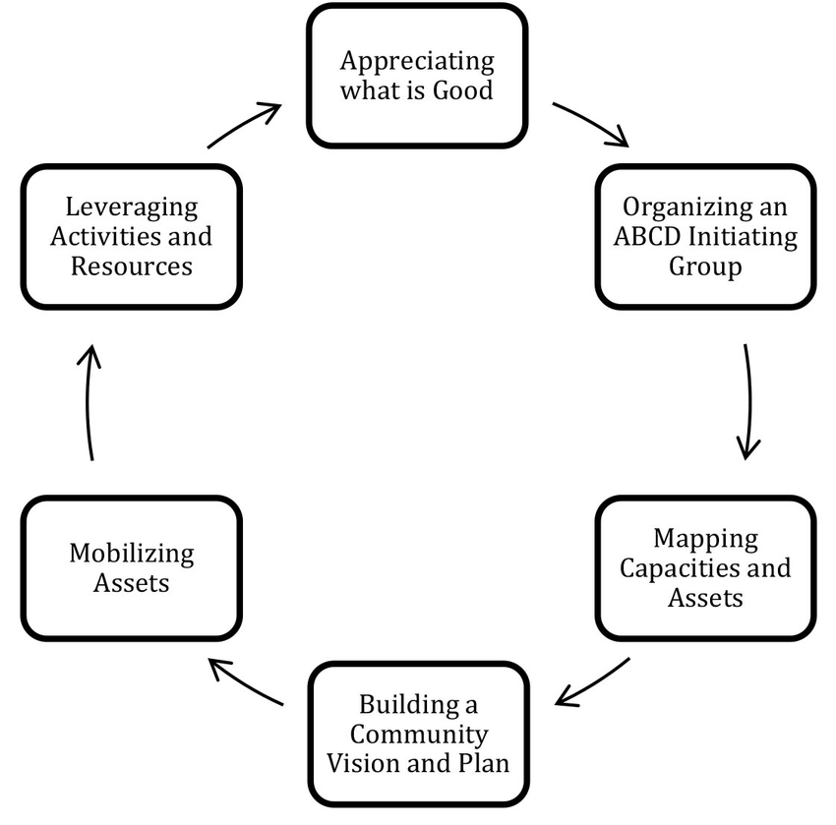
Asset Based
Community
Development/
Desarrollo
Comunitario
basado en recursos
Notes:
Over 30 learning conversations. We used that data to identify 8 projects focused on Respect and Social Inclusion. WE voted and selected 4 of those 8 to being with.

Slide 14
GUIDING STAR
All residents feel
respected and
included
in Napa County

Slide 15
ESTRELLA GUÍA
Todos los residentes se sienten respetados e
incluidos en el
condado
de Napa

Slide 16
Community Health
Action Plan
Plan de acción de Salud
Comunitaria
Notes:
EN

Slide 17
Contents of an action plan
What action or change will occur?
Who will carry it out?
By when (for how long)?
What resources are needed?
Communication (who should know what?)
Notes:
An action plan should show how we will implement strategies to obtain objectives listed in our CHIP. We develop an action plan so we can track details, check for feasibility, increase efficiency and ensure accountability. It’s also a way to articulate our plans clearly to outside partners and potential funders. We should just think about this as our workplan.

Slide 18
Contenido de un plan de acción
¿Qué acción o cambio ocurrirá?
¿Quién lo llevará a cabo?
¿Para cuándo (por cuánto tiempo)?
¿Qué recursos se necesitan?
Comunicación (¿quién debería saber qué?)
Notes:
An action plan should show how we will implement strategies to obtain objectives listed in our CHIP. We develop an action plan so we can track details, check for feasibility, increase efficiency and ensure accountability. It’s also a way to articulate our plans clearly to outside partners and potential funders. We should just think about this as our workplan.

Slide 19
Facilitate Youth discussion for the purpose of
creating accessible, equitable, free programming
and activities that are youth centered and youth
led. In order to provide feedback during this
discussion, participation barriers (transportation,
food, etc.) should be removed and youth should be compensated for their time.
PROJECT 1: Youth
Create a community guide of LGBTQ-friendly
businesses/resources. Services can advertise their
status via a rainbow icon on their website that links
to the guide, or information can be shared via an
app.
PROJECT 2: LGBTQ community
Collect narratives of residents who have accessed mental health services to create a Story Map that
highlights successes, gaps, lessons learned.
Organize a summit for mental health consumers,
families, and providers in order to identify assets
and gaps, and allow community partners to better
share resources and information.
PROJECT 3: Mental Health
Integrate cultural and language sharing through:
-Neighborhood events (potlucks, disaster preparedness,
gardens, playgroups, tandas*).
-Visual bilingual representation (bilingual signs, menus,
movies with subtitles, cultural event calendars, and
media campaign with weekly Spanish/English words or
phrases).
-Community arts/cultural activities (bilingual choirs,
garden clubs, cooking /music lessons, Zumba, game
nights).
PROJECT 4: Language

Slide 20
Given the impact of COVID-19, does this project need to change?
Dado el impacto de COVID-19, ¿es necesario cambiar este proyecto?
If so, how does it need to change?
Si es así, ¿cómo debe cambiar?

Slide 21
ACTION: Facilitate Youth discussion for the purpose of creating accessible, equitable, free
programming/activities that are youth centered and youth led. In order to provide feedback
during this discussion, participation barriers (transportation, food, etc.) should be removed and youth should be compensated for their time.
Context: How might we reduce stress for teens in Napa County?/How might we create more
low or no cost entertainment options for youth in Napa County?
Data:
Many teens reported stress as a cause of tobacco, marijuana and drug use.
Youth (and their parents) emphasized that there are few entertainment options for youth if you had no money to spend.
High-stress teens are twice as likely to smoke, drink, get drunk and use illegal drugs. Teens who report they are frequently bored are 50% more likely to smoke, drink, get drunk and use illegal drugs. (The National Center on Addiction and Substance Abuse at Columbia University, National Survey of American Attitudes on Substance Abuse VIII: Teens and Parents)
Notes:
Jessica/Rocio
How has the pandemic impacted the community or issue that this project is designed for?
Is this project still meaningful to us?

Slide 22
ACTION: Create a community guide of LGBTQ-friendly businesses and resources. Services can advertise their status via a rainbow icon on their website that links to the guide, or information can be shared via an app.
Context: How might we make clear which services are LGBTQ allies?
Data:
LGBTQ residents want to know what businesses, medical services and schools are
welcoming to their families in Napa County.
Only 55% of LGBTQ youth in Napa County report feeling safe in school.
LGBTQ residents said they want a more open-minded, accepting, safe, and positive community that celebrates all, where there is no judgment. A participant stated that he felt “accepted but not included” in Napa. (Napa Library Community Conversation)
Notes:
Jennifer/Patty
How has the pandemic impacted the community or issue that this project is designed for?
Is this project still meaningful to us?

Slide 23
ACTION: Collect narratives of residents who have accessed mental health services to create a
Story Map that highlights successes, gaps, lessons learned. Organize a summit for mental health
consumers, families, and providers in order to identify assets and gaps, and allow community partners to
better share resources and information.
Context: How might we market services to increase access and improve navigation and knowledge of
services? How might we create safe spaces for people with mental health issues to share stories and reduce stigma?
Data:
Many people shared that, while anxiety and depression were becoming more normalized, there is still a stigma around bipolar disorder and schizophrenia.
Mental Health professionals felt that great work is being done in Napa County, but the work is still
happening in siloes.
Mounting evidence suggests that Mental Health Stigma is experienced in virtually all life domains and
that it may significantly influence multiple health outcomes, including treatment seeking behavior.
Mental health stigma update: A review of consequences, Amy E Sickel, Jason D Seacat, and Nina A Nabors, Advances in Mental Health: Promotion,
Prevention and Early Intervention, Volume 12, 2014- Issue 3, Pages 202-215, Published online: 30 Jan 2015)
Notes:
Crystal/Ilse
How has the pandemic impacted the community or issue that this project is designed for?
Is this project still meaningful to us?

Slide 24
Action: Integrate cultural and language sharing through:
Neighborhood events (potlucks, disaster preparedness, gardens, playgoups, tandas*).
Visual bilingual representation (bilingual signs, menus, movies with subtitles, cultural event
calendars, and media campaign with weekly Spanish/English words or phrases).
Community arts & cultural activities (bilingual choirs, garden clubs, cooking & music lessons,
Zumba or game nights).
Context: How might we increase opportunities for English/Spanish language sharing?
Data:
Both English-speaking and Spanish-speaking residents in Napa County described a noticeable
division between Latinx and White communities in Napa County, naming language as a barrier
to connection.
In addition to promoting cross-cultural communication, bilingualism has positive effects at both
ends of the age spectrum: Bilingual children as young as seven months can better adjust to
environmental changes, while bilingual seniors can experience less cognitive decline.
The Cognitive Benefits of Being Bilingual, Viorica Marian, Ph.D and Anthony Shook, Cerebrum 2012 Sep-Oct, https://www.ncbi.nlm.nih.gov/pmc/articles/PMC3583091/
Notes:
Erin/Nancy
*Tandas are informal group of friends/family that gather money each week/month and lend it to each member of the group in a set order at a specified time.
How has the pandemic impacted the community or issue that this project is designed for?
Is this project still meaningful to us?

Slide 25
Contents of an action plan
What action or change will occur?
Who will carry it out?
By when (for how long)?
What resources are needed?
Communication (who should know what?)
Notes:
An action plan should show how we will implement strategies to obtain objectives listed in our CHIP. We develop an action plan so we can track details, check for feasibility, increase efficiency and ensure accountability. It’s also a way to articulate our plans clearly to outside partners and potential funders. We should just think about this as our workplan.

Slide 26
Contenido de un plan de acción
¿Qué acción o cambio ocurrirá?
¿Quién lo llevará a cabo?
¿Para cuándo (por cuánto tiempo)?
¿Qué recursos se necesitan?
Comunicación (¿quién debería saber qué?)
Notes:
An action plan should show how we will implement strategies to obtain objectives listed in our CHIP. We develop an action plan so we can track details, check for feasibility, increase efficiency and ensure accountability. It’s also a way to articulate our plans clearly to outside partners and potential funders. We should just think about this as our workplan.

Slide 27
Aligned through Design
Improving health equity in Napa County through shared data and human-centered strategies
Notes:
Briefly mention grant/funding for projects

Slide 28
Alineado a través de diseño
Mejorar la equidad en la salud en el condado de Napa a través de datos compartidos y estrategias centradas en el ser humano
Notes:
Briefly mention grant/funding for projects

Slide 29
Questions? ¿Preguntas?

Slide 30
Closing
We will:
Share meeting outcomes through email and website: http://www.livehealthynapacounty.org/
Next LHNC meeting is September 21, 2021
Please complete survey, link is in the chat.
THANK YOU for participating!

Slide 31
Cierre
Vamos a :
Compartir los resultados de la reunión a través del correo electrónico y el sitio web: http://www.livehealthynapacounty.org/
La próxima reunión de LHNC es el 21 de septiembre de 2021
Por favor complete la encuesta, el enlace está en el chat.
¡Gracias por participar!

