Slide 1
Somos Cuidadores We are Caregivers
- a Stanford d.school human-centered design project led by Community Resources for Children and First 5 Napa County. Generously supported by Live Healthy Napa County

Slide 2
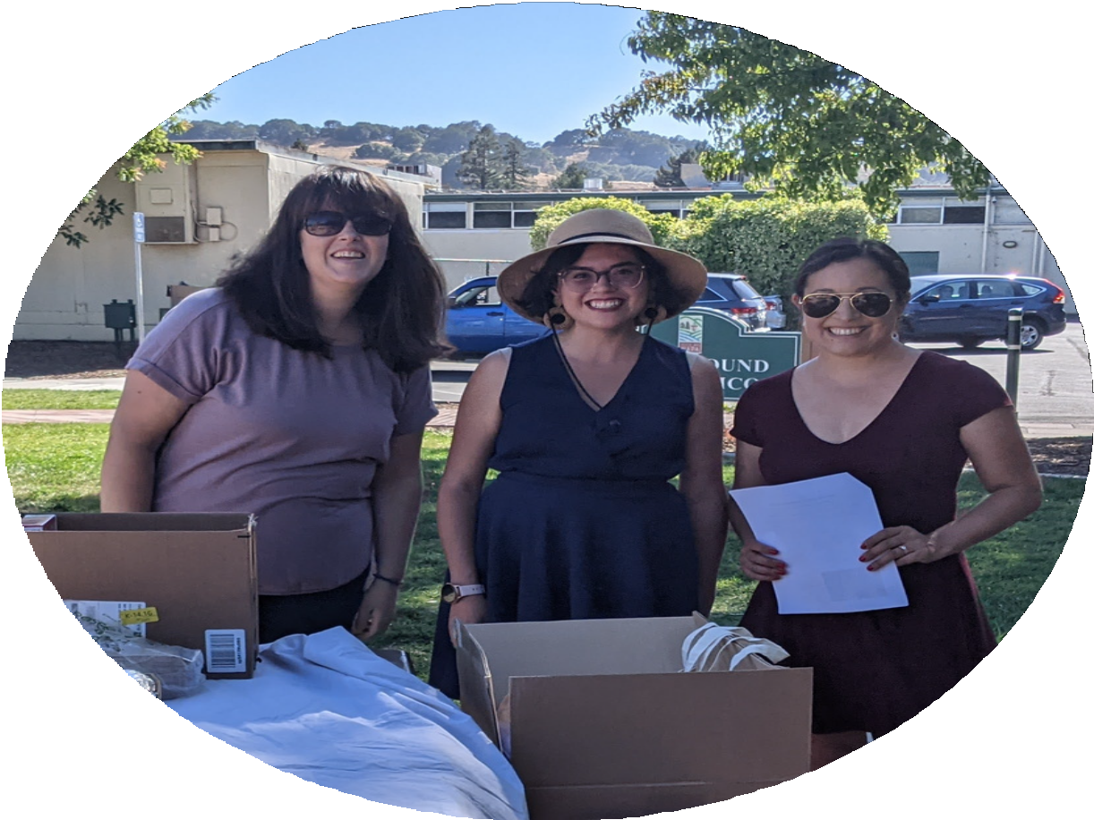
d.school Team
EMILY DARLINGTON
Quality Counts Program Manager First 5 Napa County
EVA SIMONSSON
Associate Director
Community Resources for Children
LILEA HEINE
Community Programs Coordinator First 5 Napa County
MARIA TORRES
Community Member
STEPH SHIEH
Manager of Parent and Caregiver Engagement Programs, Community Resources for Children
MARIA LLAMAS CONTRERAS
Family Support Services Manager Community Resources for Children

Slide 3
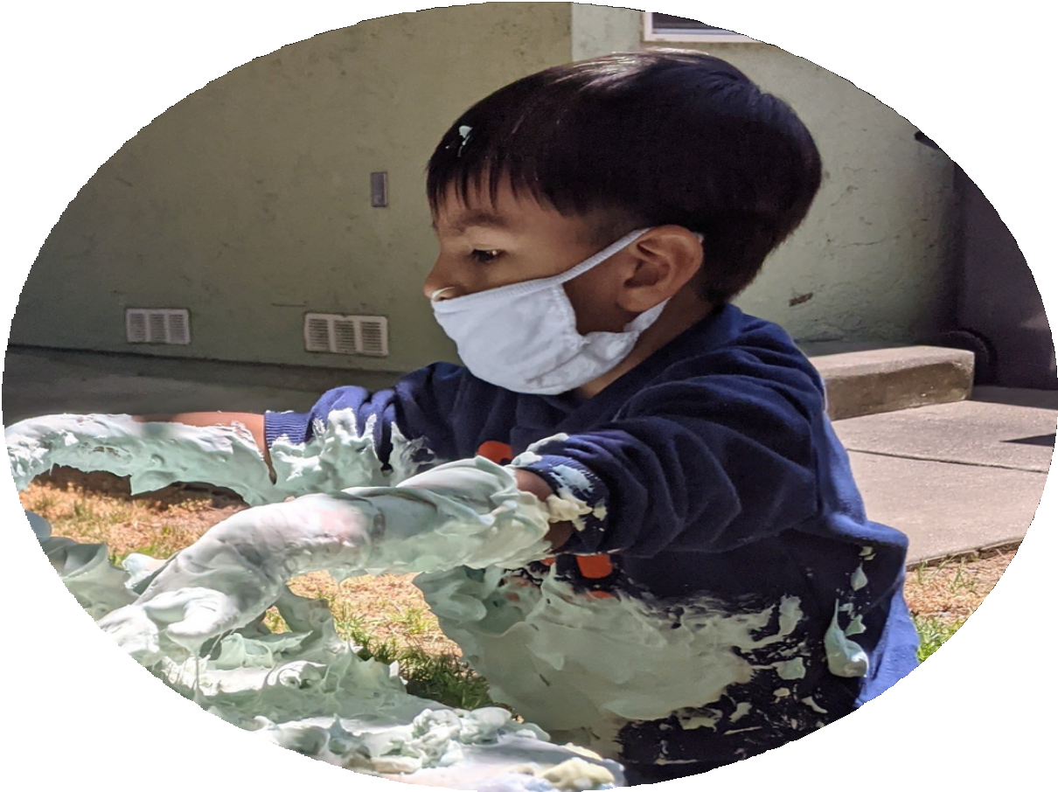

Children in FFN Care in California
FFN providers are home-based caregivers working outside of the formal child care system. They are unlicensed or license- exempt and provide care to the children of a family member, friend, and/or neighbor.
80% of young children in California age 0-2
~40% of children age 0-5 are cared for by FFNs
- The David and Lucile Packard Foundation

Slide 4
Project Details
01
Our Starting Challenge:
Create ways for FFNs to connect to community services and to provide quality early learning experiences to the children under their care who are not part of formal systems of care.
03
Design Process:
Met in small, Spanish-speaking learning groups Conducted interviews with FFNs/LEPs
04
Learnings/Wonderings:
How might we connect with FFNs where they gather? How might we create opportunities for FFNs to connect, learn and reflect with each other?
02
Participants:
Focus on Spanish-speaking caregivers and stakeholders with input from parents who utilize FFN care and English-speaking grandmother who is connected to resources.
05
Prototype:
An informal gathering for Spanish-speaking, home-based child care providers to connect, learn and reflect on July 8th, 2021 held at Playground Fantastico at 5:30pm.

Slide 5
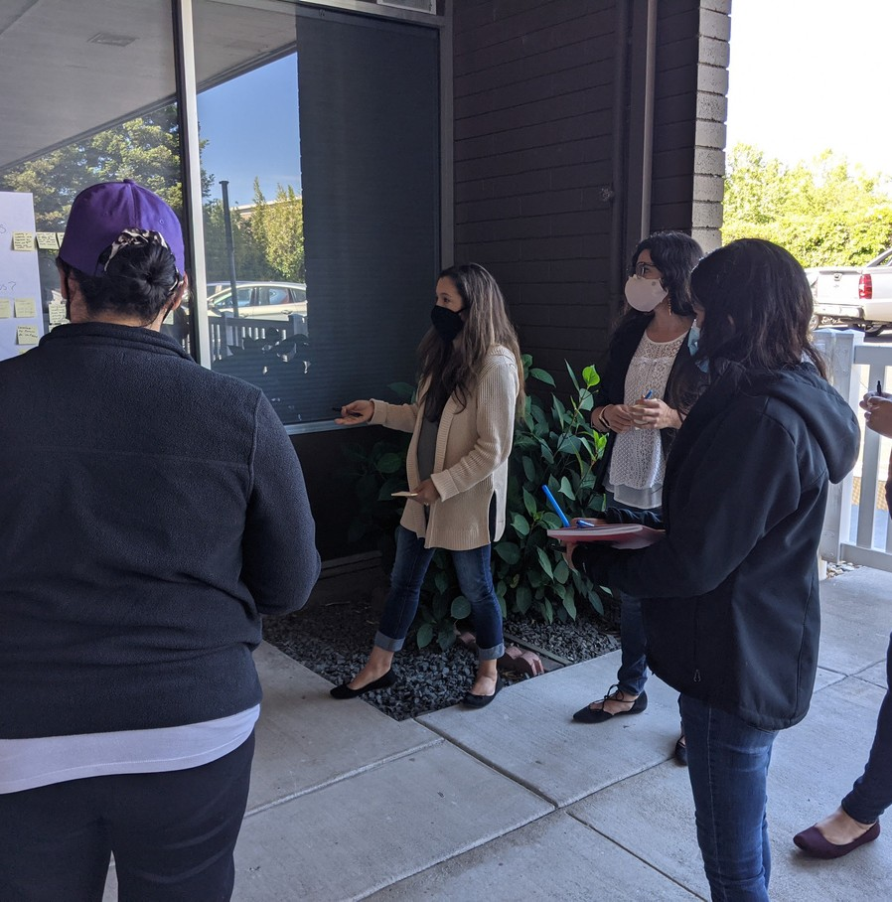
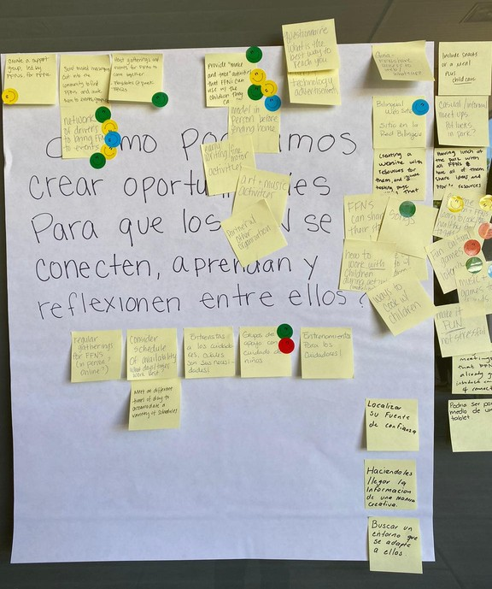
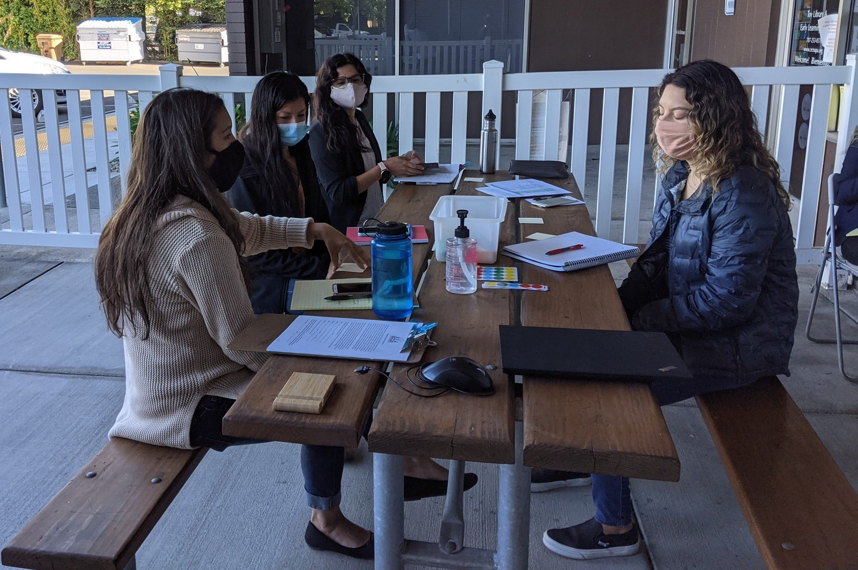
Interviews &
Co-design session:
Interviews in Spanish and English Co-design session in Spanish only Participants
Resident Services Coordinator at NVCH Head Start Teacher
Mother who uses FFN Care
1 FFN Caregiver, not part of formal system 1 FFN caregiver in CRC's AP program
1 English-speaking grandmother connected to community resources

Slide 6
What did we learn through interviews?
FFNs struggle with finding time for themselves:
Grandmother taking care of grandchildren. She is so exhausted and doesn’t have any time for herself. Her health is declining.
Experience with Early Learning Activities: Many families have not had formal education opportunities. Some left school at age 6 or 8 in order to work. They don’t have experience playing or doing activities. They are now first and foremost concerned with taking care of themselves and their families.
Early learning is not prioritized because they haven’t had the opportunity themselves.
Cultural perspectives: “Everyone has a child inside of them... (FFNs) need to know you are allowed (to let that child out)". Interviewee shared the story of a parent that asked for permission to participate in an activity with her child. Of her culture she shared “if you are not invited to do something you don’t do it”

Slide 7
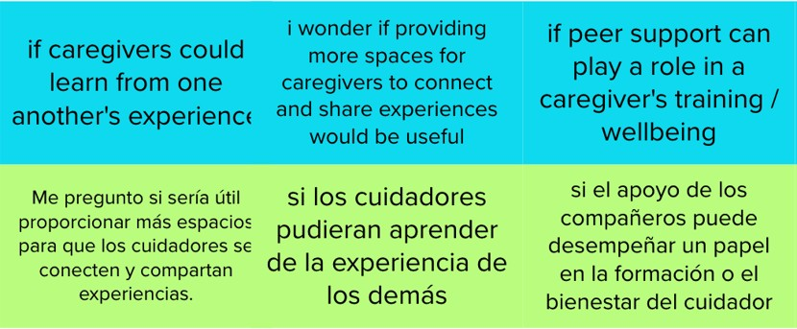
Wonders and Opportunities / Oportunidades

Slide 8
How might we / Como podriamos

Slide 9
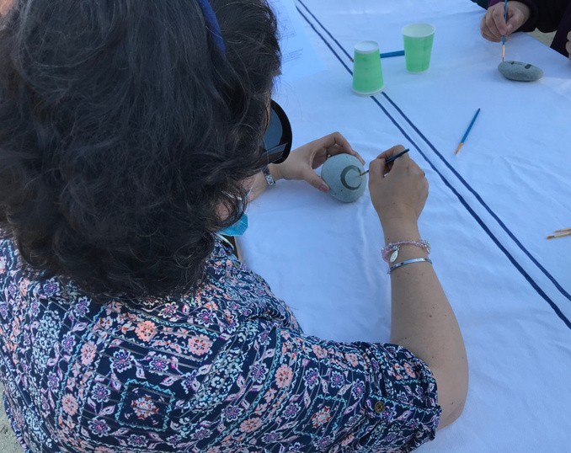
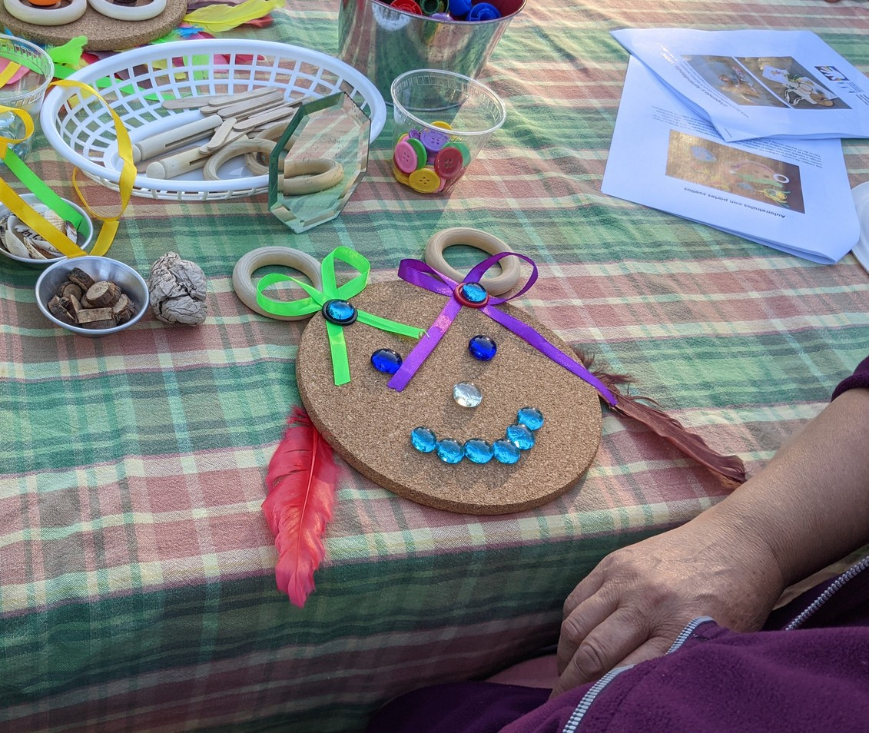
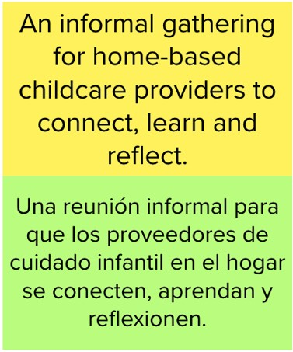
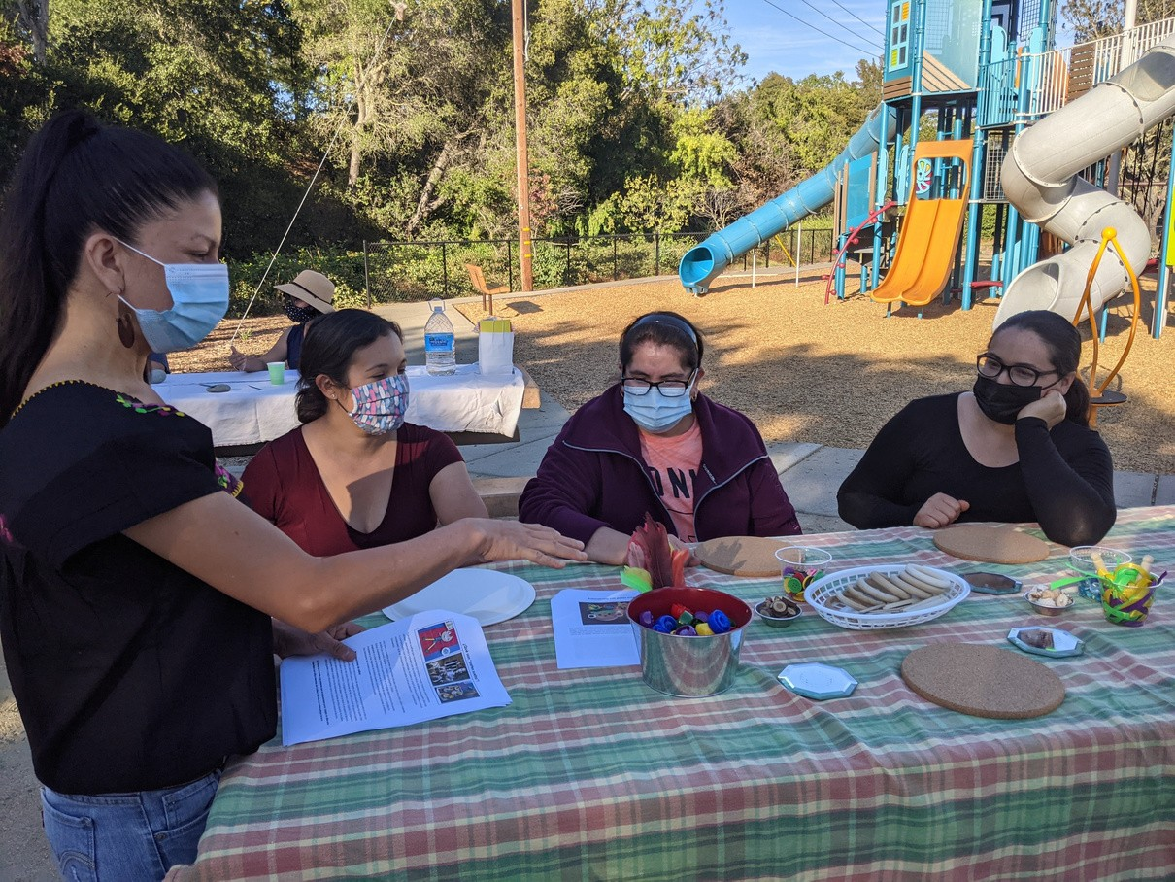
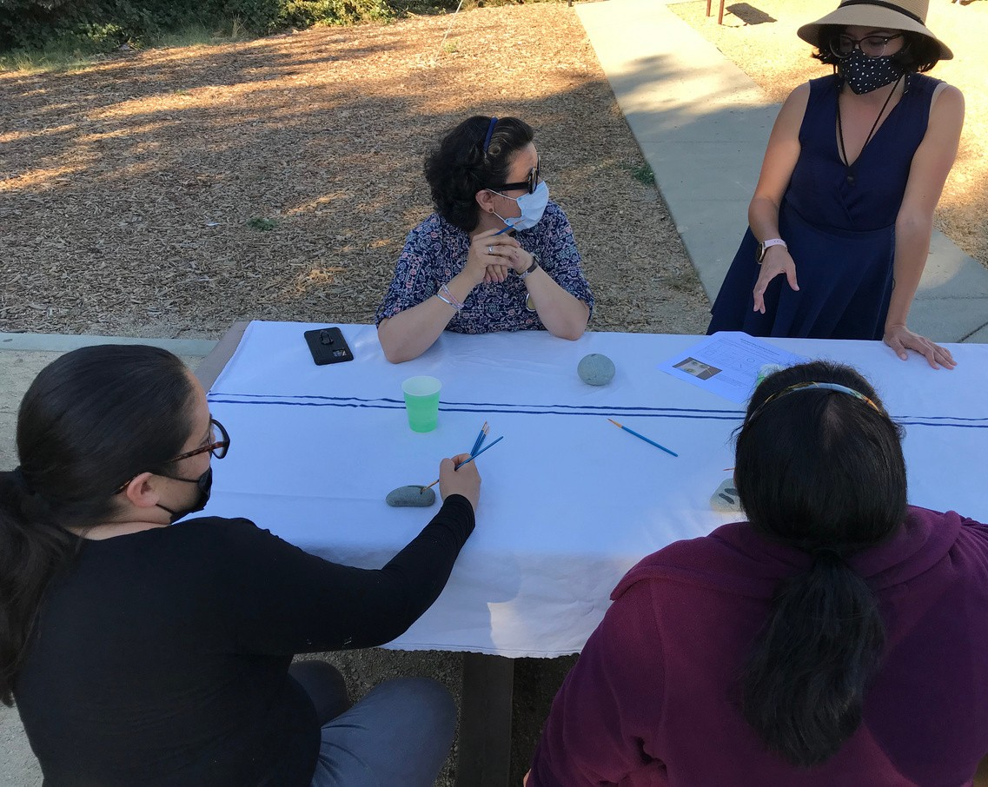
Prototype:
Food
Activities
Raffle Convenient location
In Spanish
Trusted Messengers

Slide 10
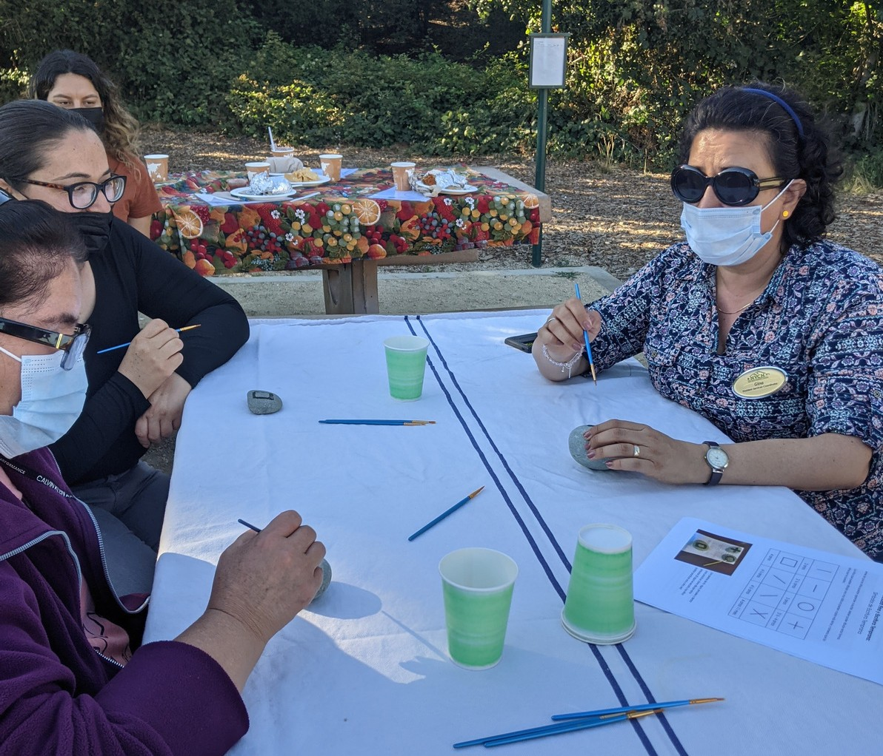

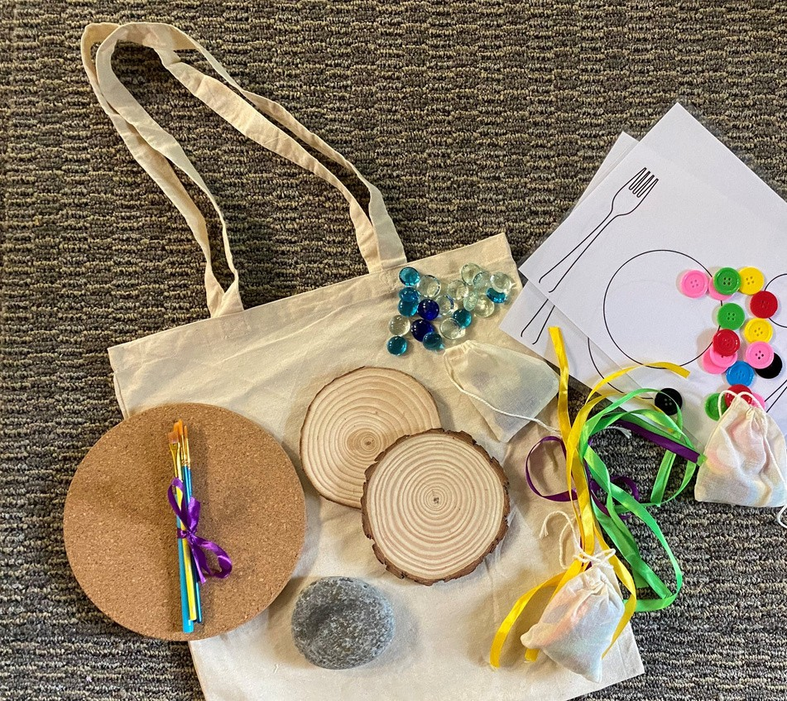
Early learning activities:
Using household items
Modeling
Make it fun!

Slide 11
What we learned:
Importance of trusted messengers & convenient locations
Some FFNs did not grow up with activities - show them and empower them to participate, interested in learning
FFNs are busy; events need to help them in other ways - provide food and additional food to bring home so that they don't have to cook
Lead in Spanish!
Best way to communicate Make it fun!
FFNs want to gather at these types of events
Food
Activities
Convenient location
In Spanish
Trusted Messengers

Slide 12
Next Steps...
CRC & First 5 Collaboration
Meeting to discuss details as we move forward with this project
CRC's FFN Programs continue
Monthly Playgroups at NVCH locations, online playgroups, caregiver cafe (using dSchool project as a model) support group
CRC New Position - FFN Project Manager
Advocacy on behalf of FFNs continues
Participate in discussions about needed supports for FFN caregivers

