Slide 1
Queerly and Culturally Responsive Spanish
Lilea Heine
Community Programs and Network Manager
First 5 Napa County
Lilea@First5Napa.org
Fernando Espinoza
Program Director
LGBTQ Connection
fernando@lgbtqconnection.org
Notes:
Emily/Lilea

Slide 2
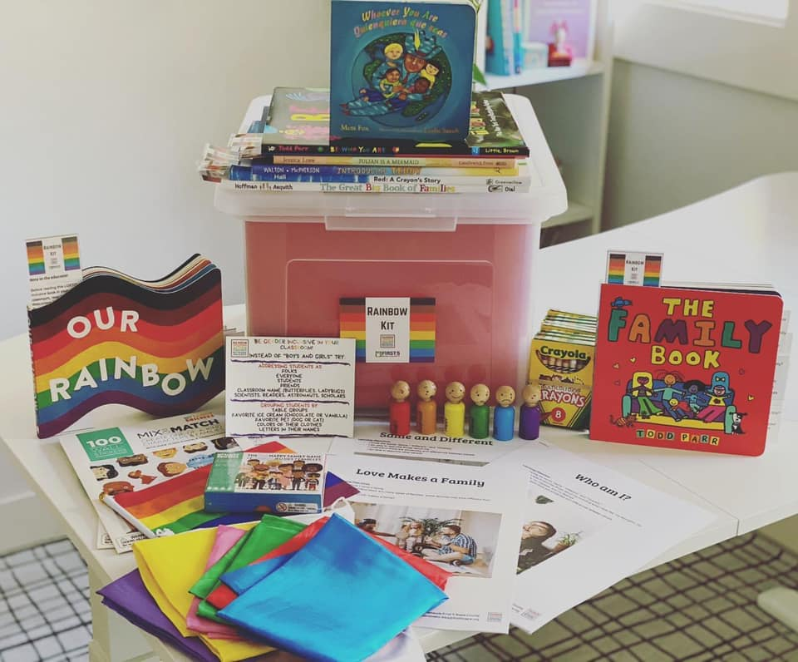
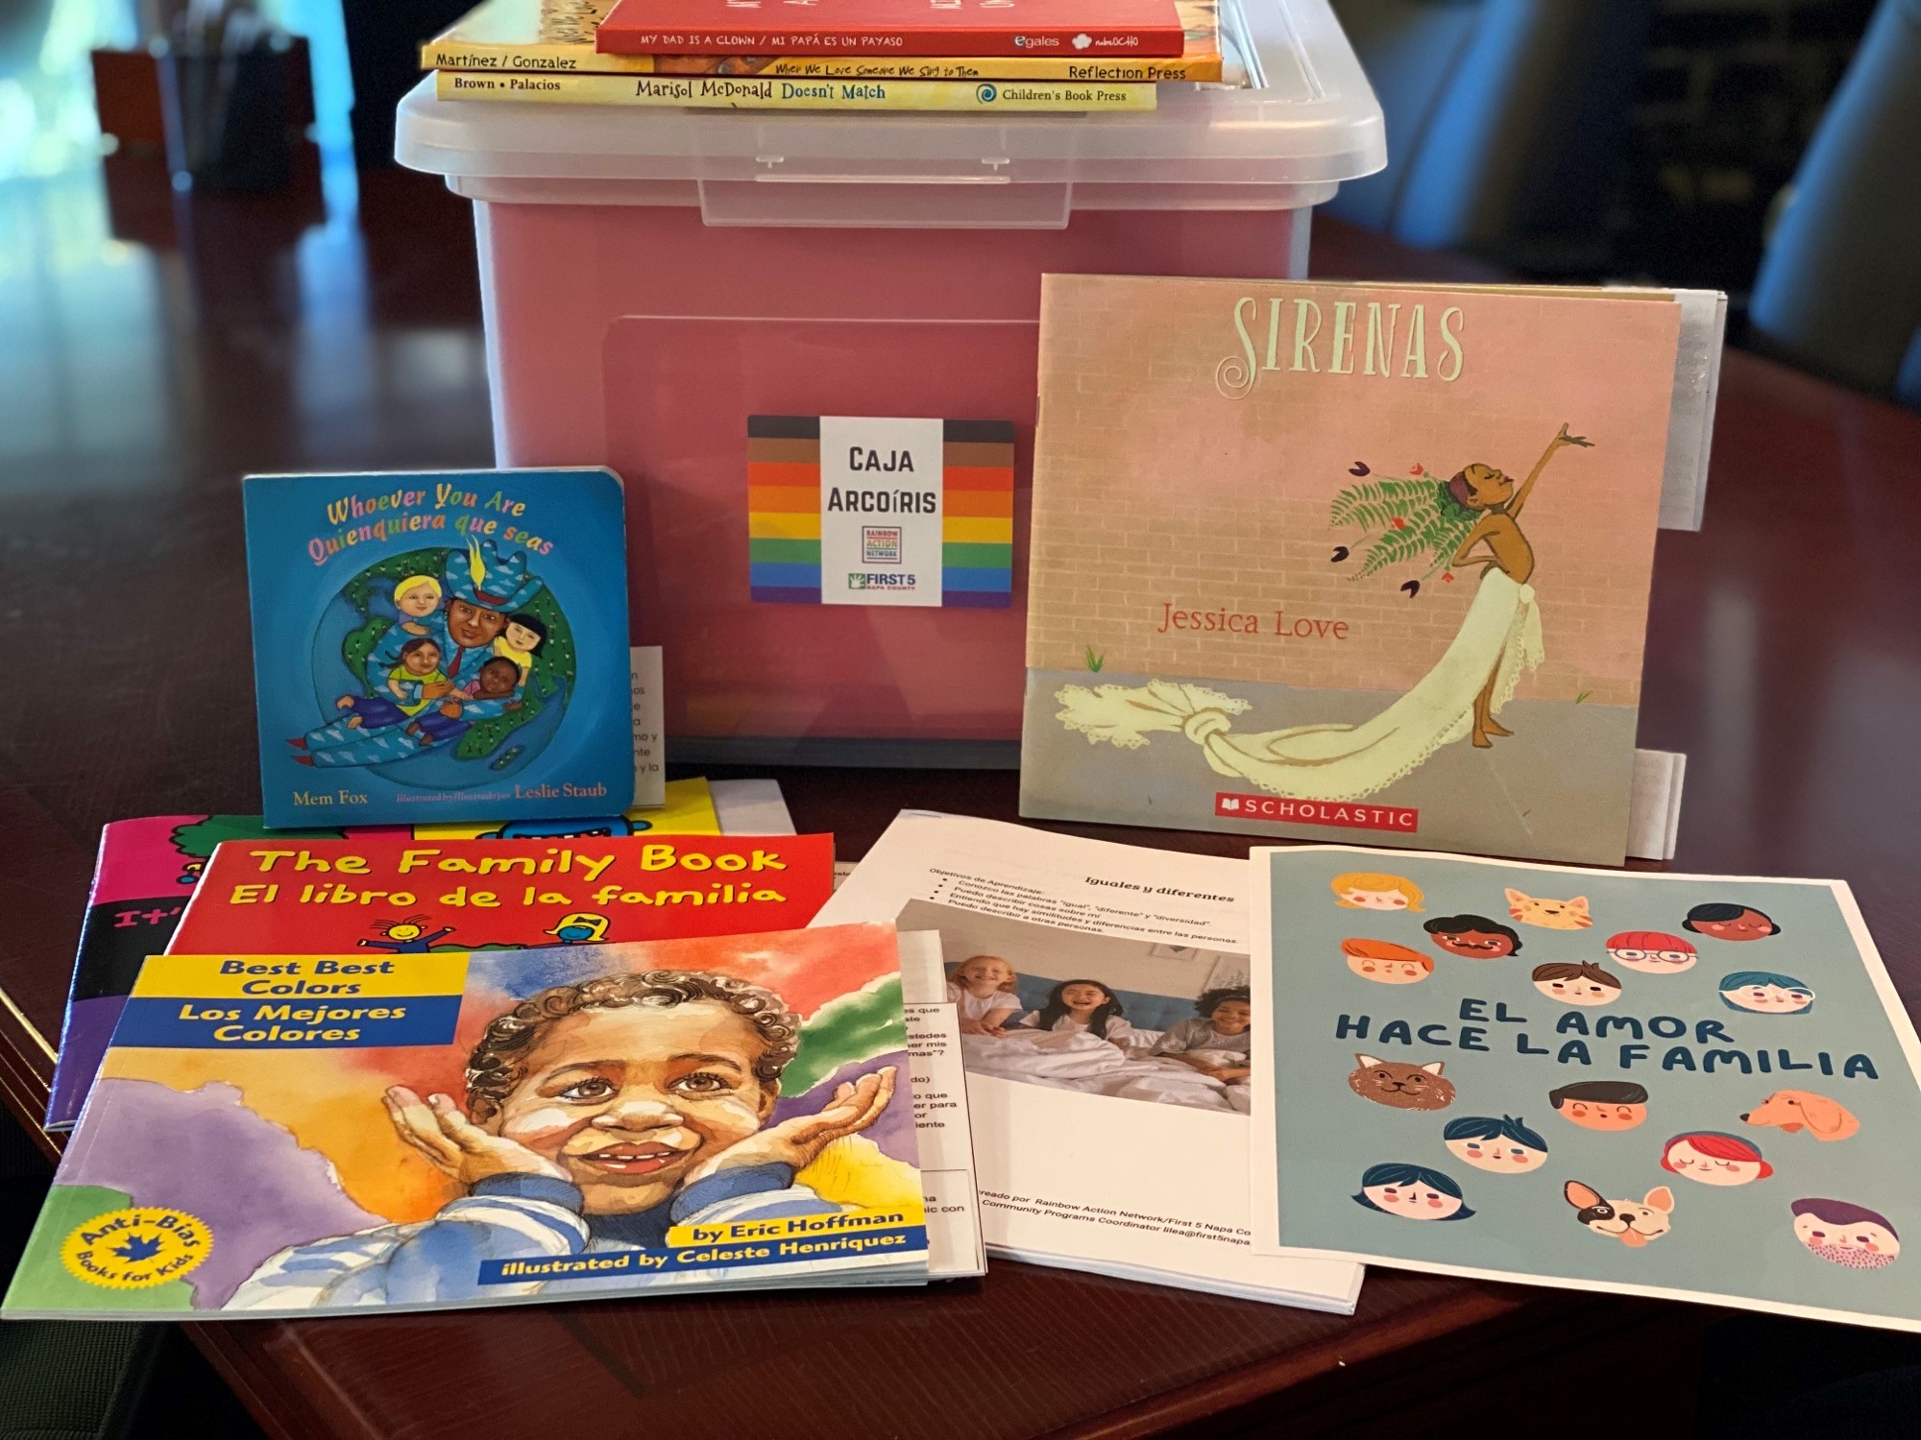
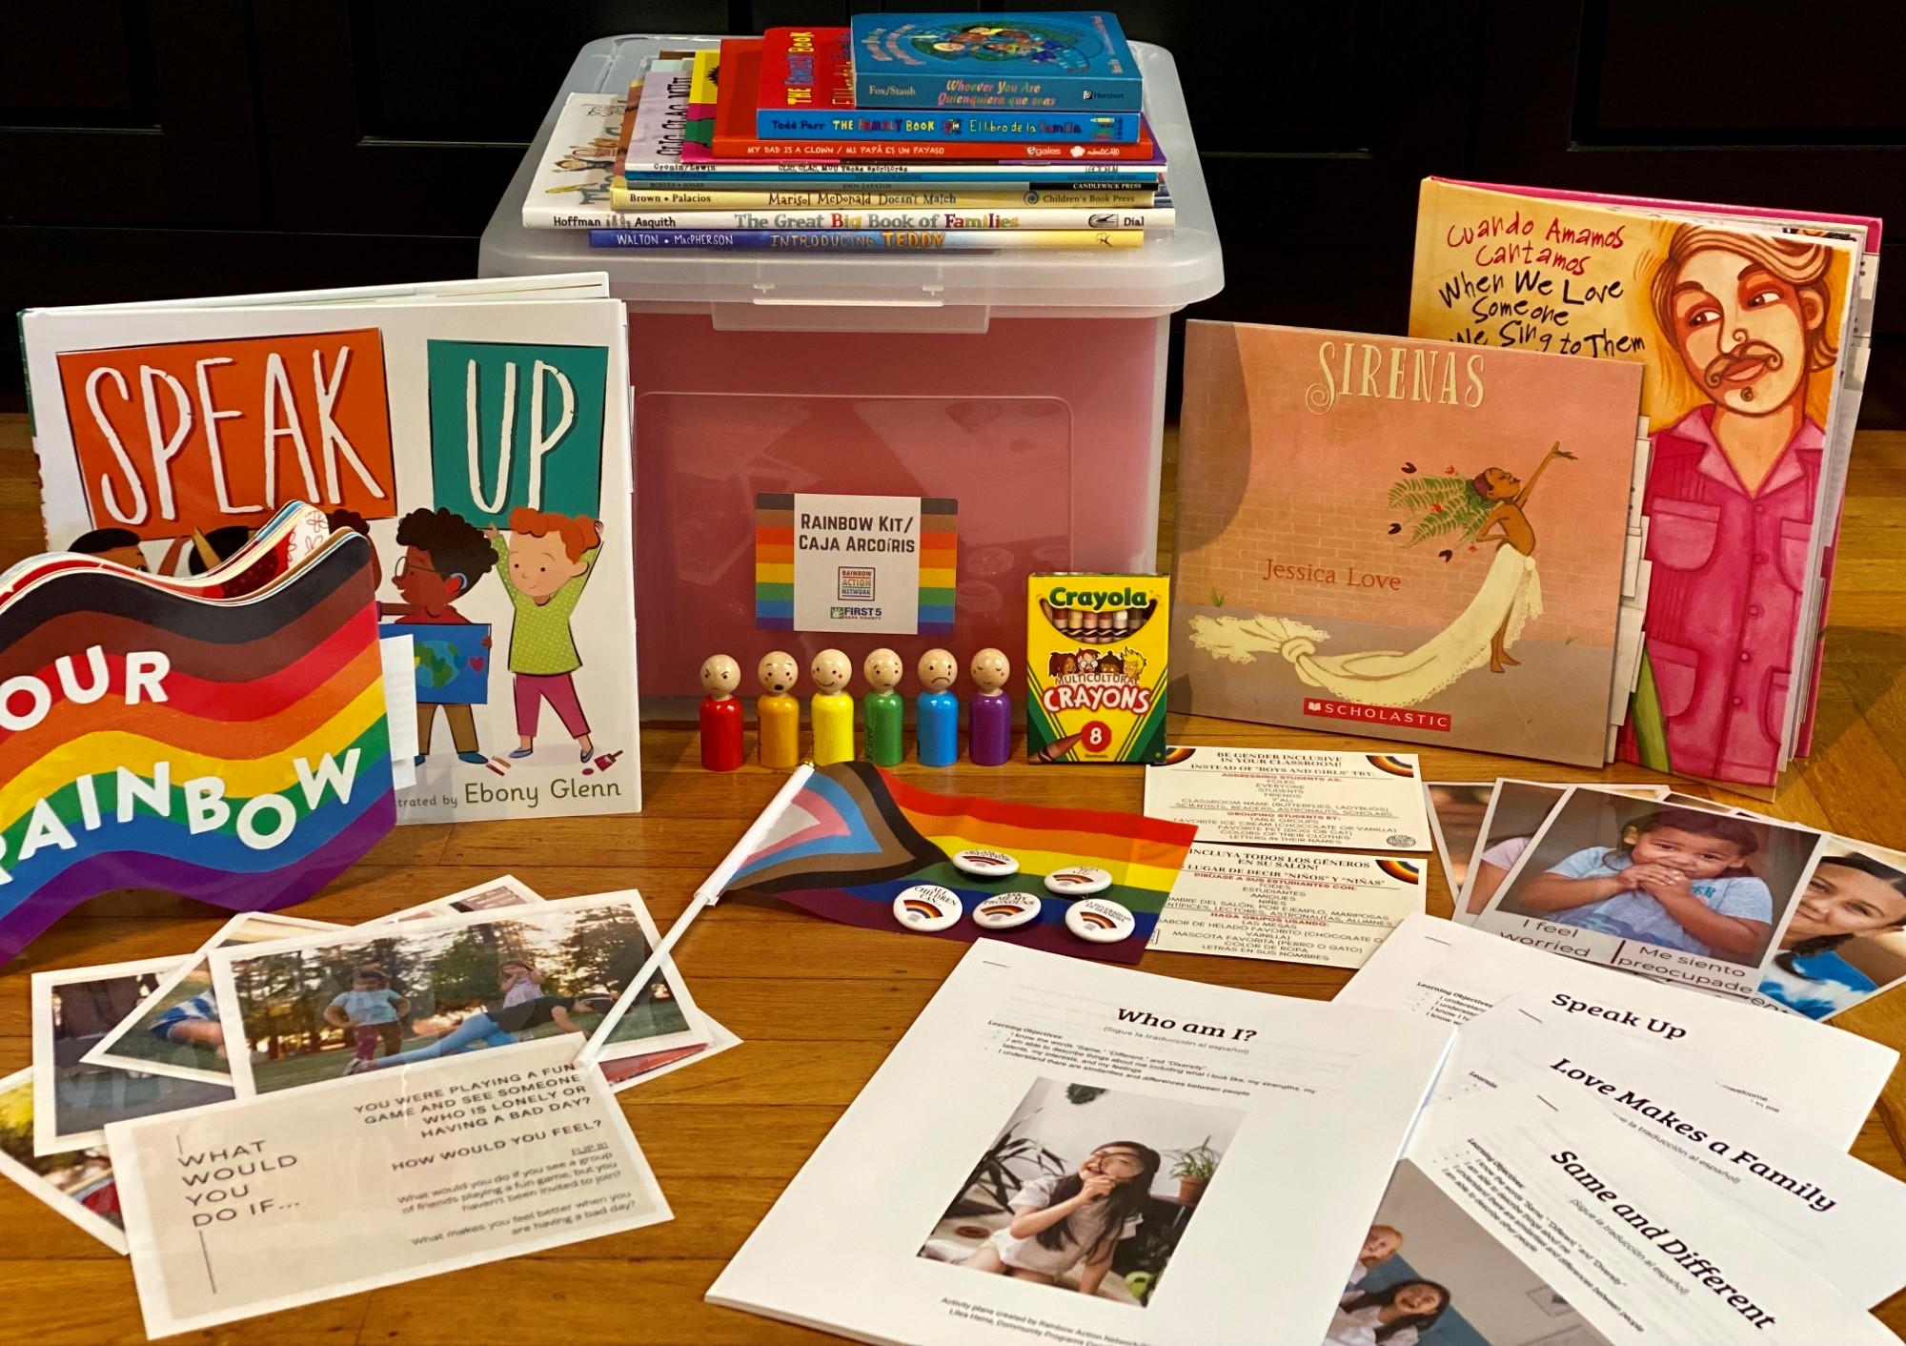
Rainbow Kit Evolution
English Kit Prototyped Spanish Language Kit
2019 2020
New in 2022: Bilingual (English/Spanish) Rainbow Kits
1 resource
As inclusive as possible
Notes:
Lilea

Slide 3
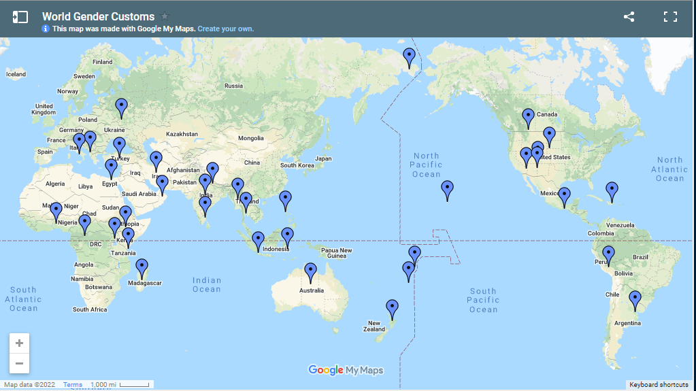
Gender Diverse Cultures around the world
Notes:
Emily
A Map of Gender-Diverse Cultures | Independent Lens | PBS
5 minutes explore map
5 minutes share with a partner

Slide 4
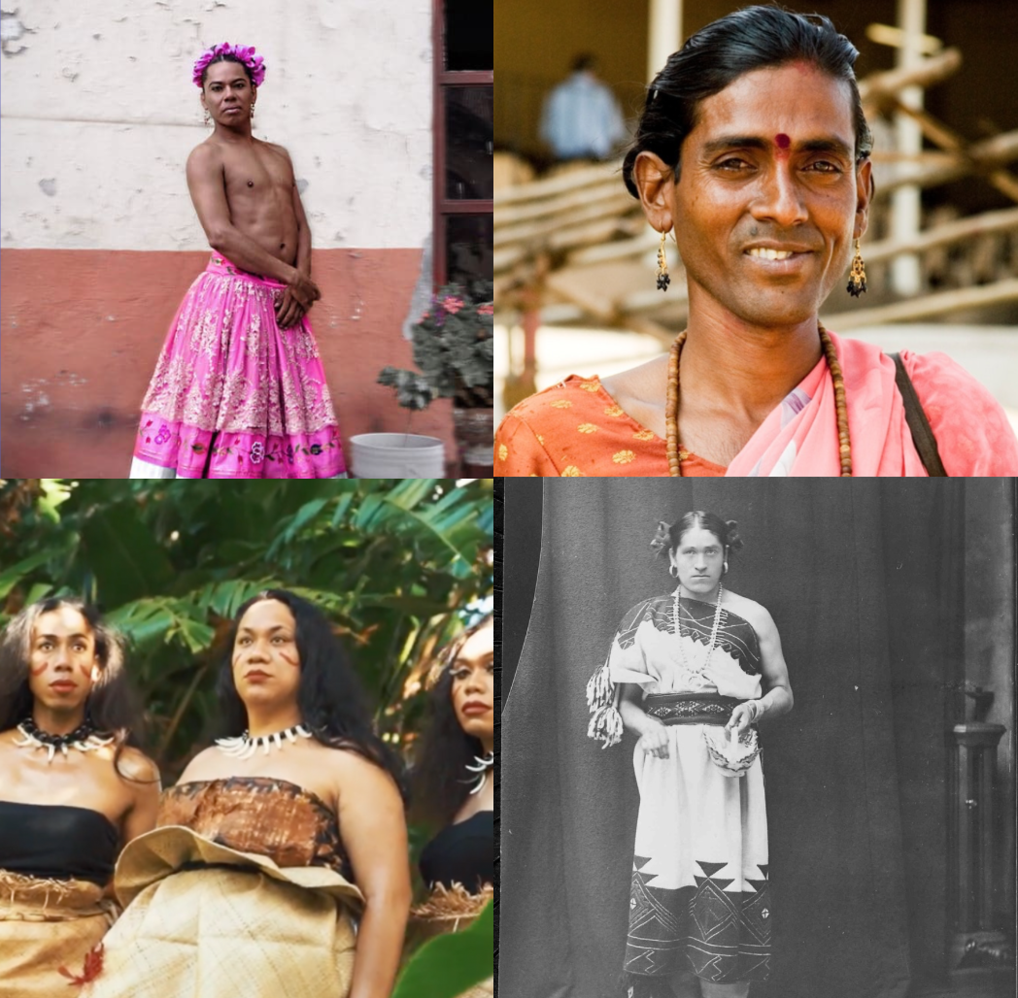
How did gendered language begin?
Notes:
(Emily) 5 minutes - Share aha moments from break out room
When addressing the current urgency to make Spanish language more inclusive of female-identifying and non-binary identities around the world, it is imperative to address the understanding of two-spirit gender identity that corresponds to precolonial Indigenous systems in the Americas.

Slide 5
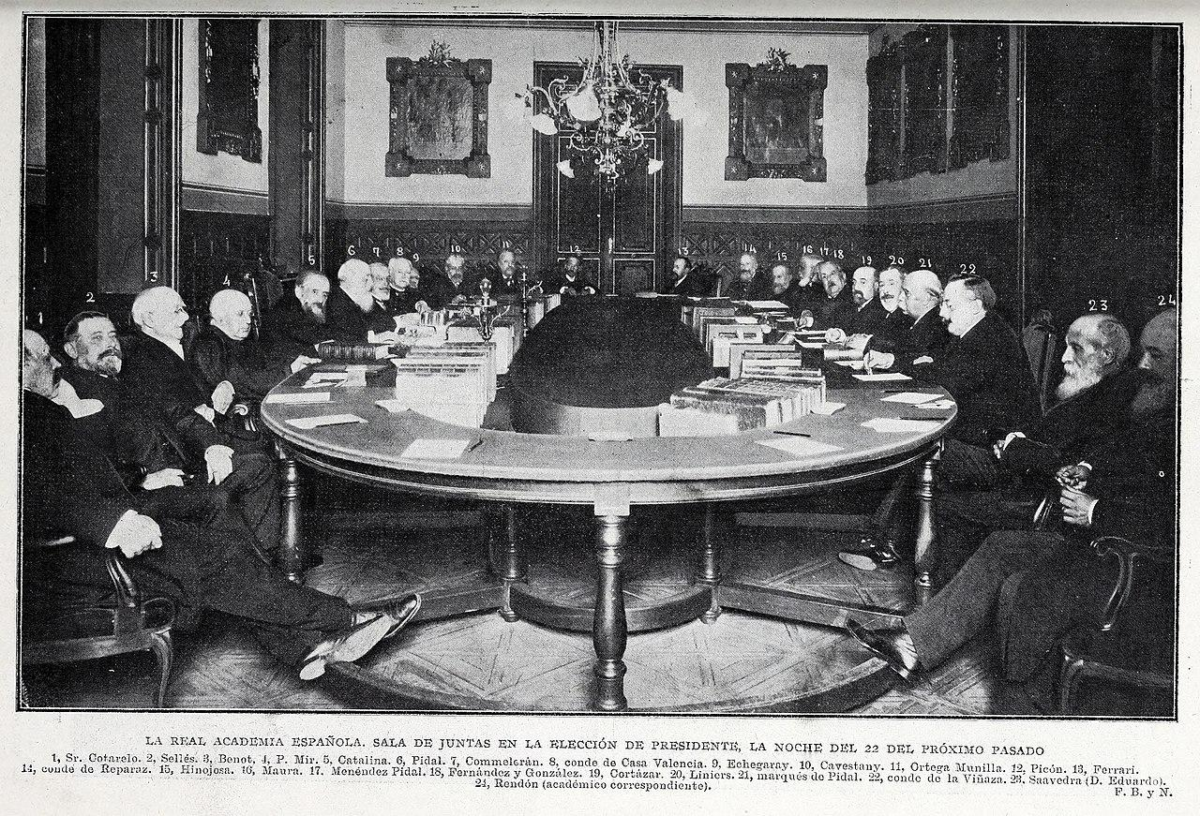
How did gendered language begin?
Royal Spanish Academy (RSA)
Founded 1713
Primary goal has been to ensure the stability of the Spanish language.
The traditional gender-binary Spanish only uses male and female nouns but does contain masculine (el ‘he ’) , feminine (ella ‘she ’), and neutral (it ‘ello ’) pronouns and adjectives. However, the gender-neutral pronoun ello refers to inanimate nouns used for non-living things.
Ejemplo/Example:
Ana trató de localizarlos en cuanto tuvo fuerzas para ello.
Ana tried to find them as soon as she had the strength for it.
It being Ana's act of trying to find them.
Notes:
Fern

Slide 6
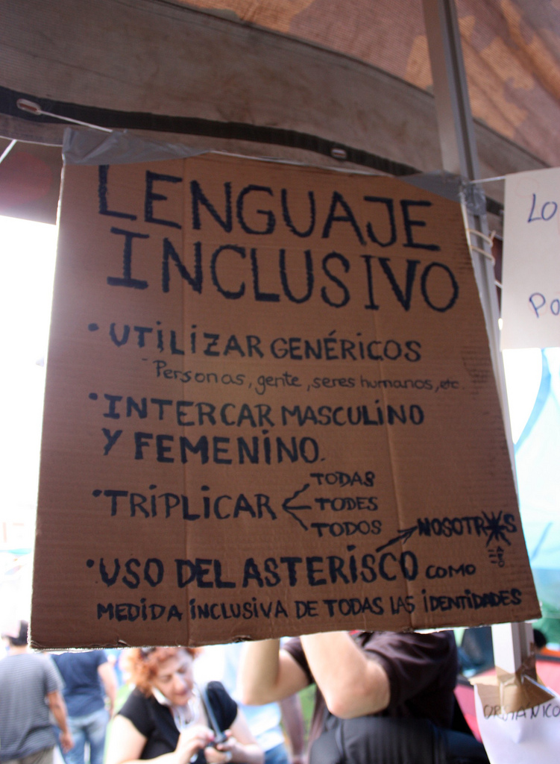
Why does it need to change?
In being culturally responsive:
We must question how the Spanish colonial rule erased the understanding of a more expansive gender identity spectrum from indigenous cultures in the Americas.
Notes:
Fern
The hypothesis of linguistic relativity originating from German humanistic thinking states that the language an individual speaks affects and influences their thinking and non-linguistic cognition (Scotto & Perez, 2020). Consider the invalidating impact that linguistic binary distinction of animate pronouns, nouns, and adjectives has on female-identifying and non-binary individuals' identity formation process as they learn the Spanish language.

Slide 7
Why does it need to change?
The Spanish language should match the reality of those who speak it, including the LGBTQ+ community
Feelings
Folks who have had feelings/thoughts about their gender identity or sexual orientation, but have not acted on them
Behaviors
Folks who have had feelings/thoughts about their gender identity or sexual orientation and have acted on them
Graphic inspired by our friends at LGBTQ Connection
Identify
Folks who identify as part of the LGBTQ community in a poll.
(8.3% of Napa County)
Notes:
Fern

Slide 8
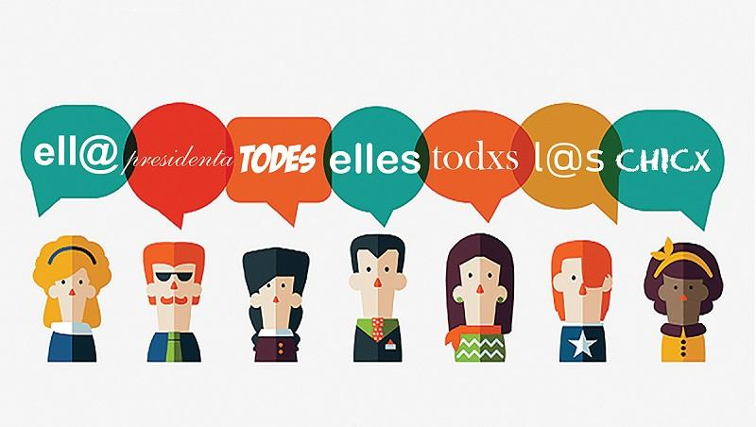
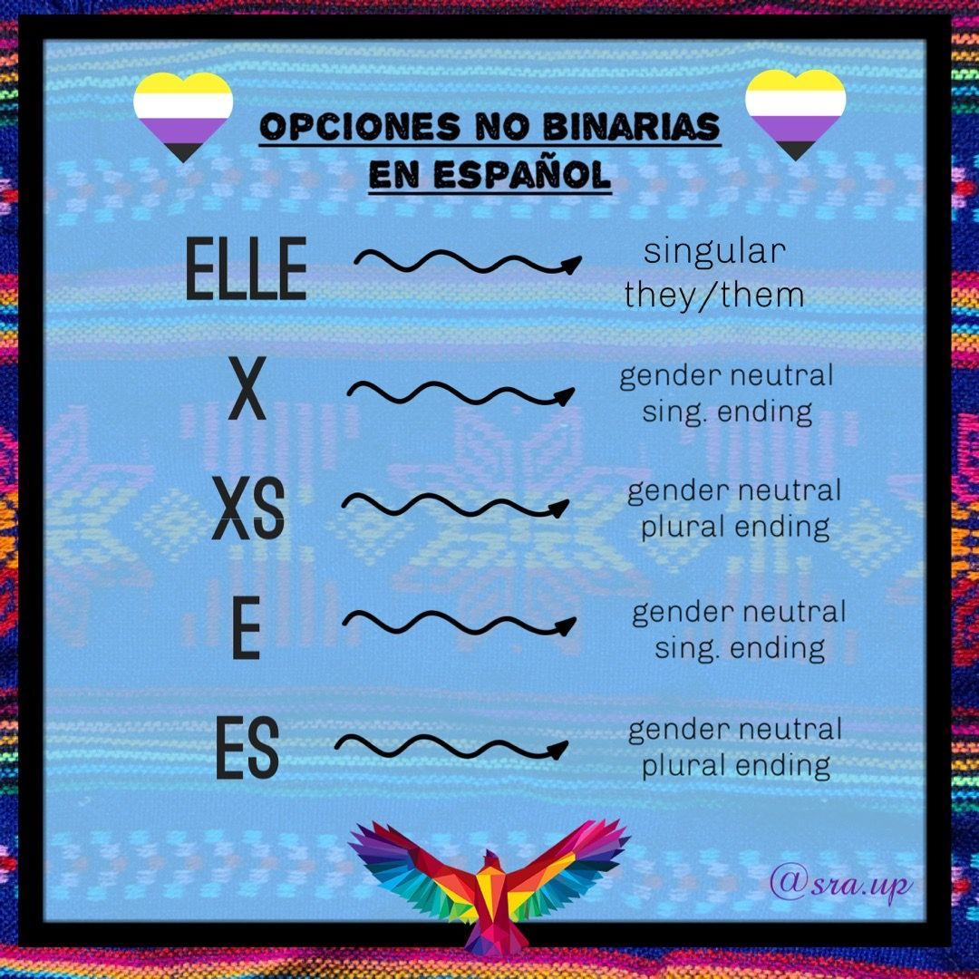
Gender Inclusive Spanish Options

Slide 10
Spanish Language Evolution
“E”
In use for 10 years (Argentina)
Movement led by feminists, the LGBTQ+ community and linguist scholars .
The main purpose of incorporating the letter “e” is to bring visibility to non-binary individuals and to make plural animate forms more inclusive of female- identifying and non-binary individuals.
Ending that is already used in Spanish (Estudiantes, Ustedes)

Slide 11
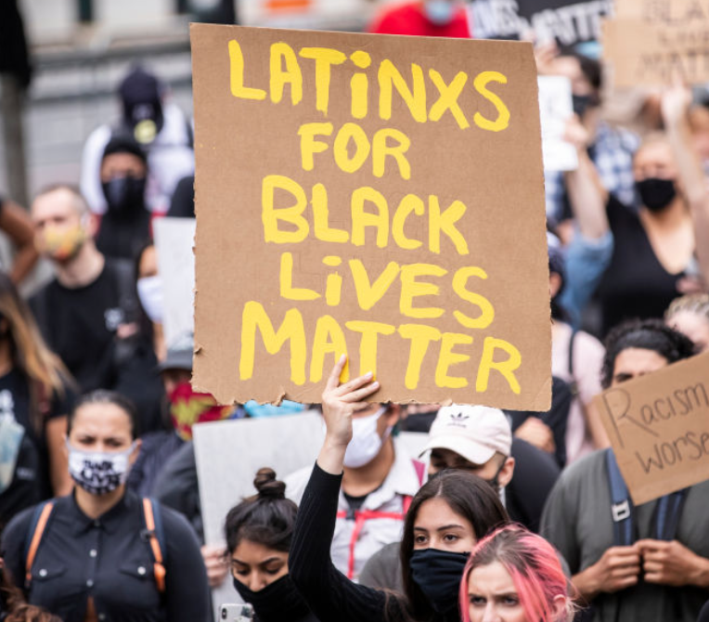
Spanish Language Evolution
“X”
Used among Spanish speaking communities in the U.S around 2004.
The purpose of the letter “x” in “Latinx” was not only to make this word inclusive of gender-non conforming people also brought visibility to Afro Latinx population that is often so invisible among Latin American communities
Notes:
Fern

Slide 12
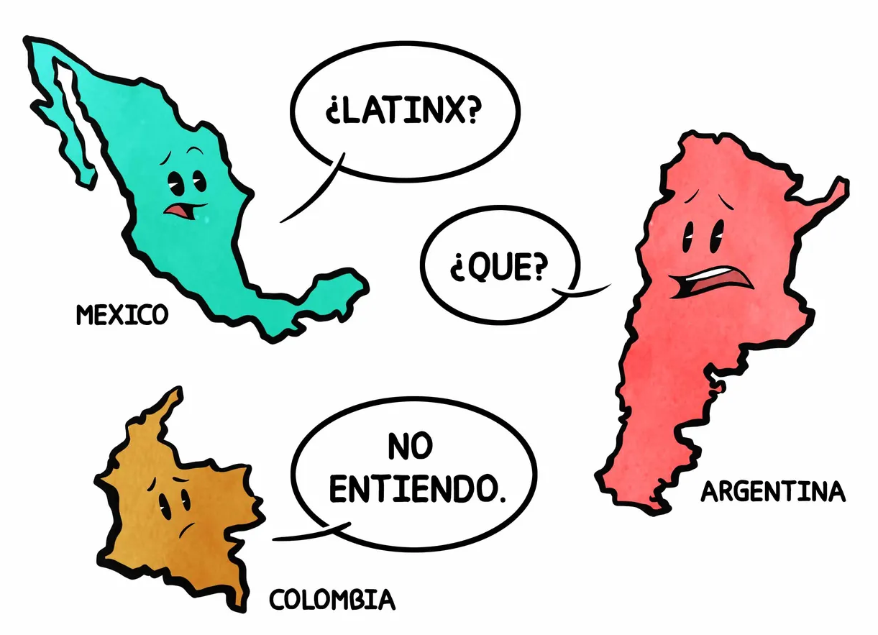
Latinx
Pew Research Center: “only 23% of U.S. adults who self-identify as Hispanic or Latino have heard of the term Latinx, and just 3% say they use it to describe themselves.” (Latinx Used by Just 3% of U.S. Hispanics. About One-in-Four Have Heard of It. | Pew Research Center)
How you pronounce Latinx? How is X pronounced in other countries we use the Latinx label for? The x in Spanish makes a “s” (Xochitl) or “h” (Oaxaca) sound
Notes:
Fern
Lilea with share from Emily

Slide 13
Chat Reflection:
What surprised you?
What was new?
What were your “A-ha” moments?
Notes:
Fern
Emily
Break out - Reflection - What surprised you? What was new? A ha moments

Slide 14
Implementation

Slide 15
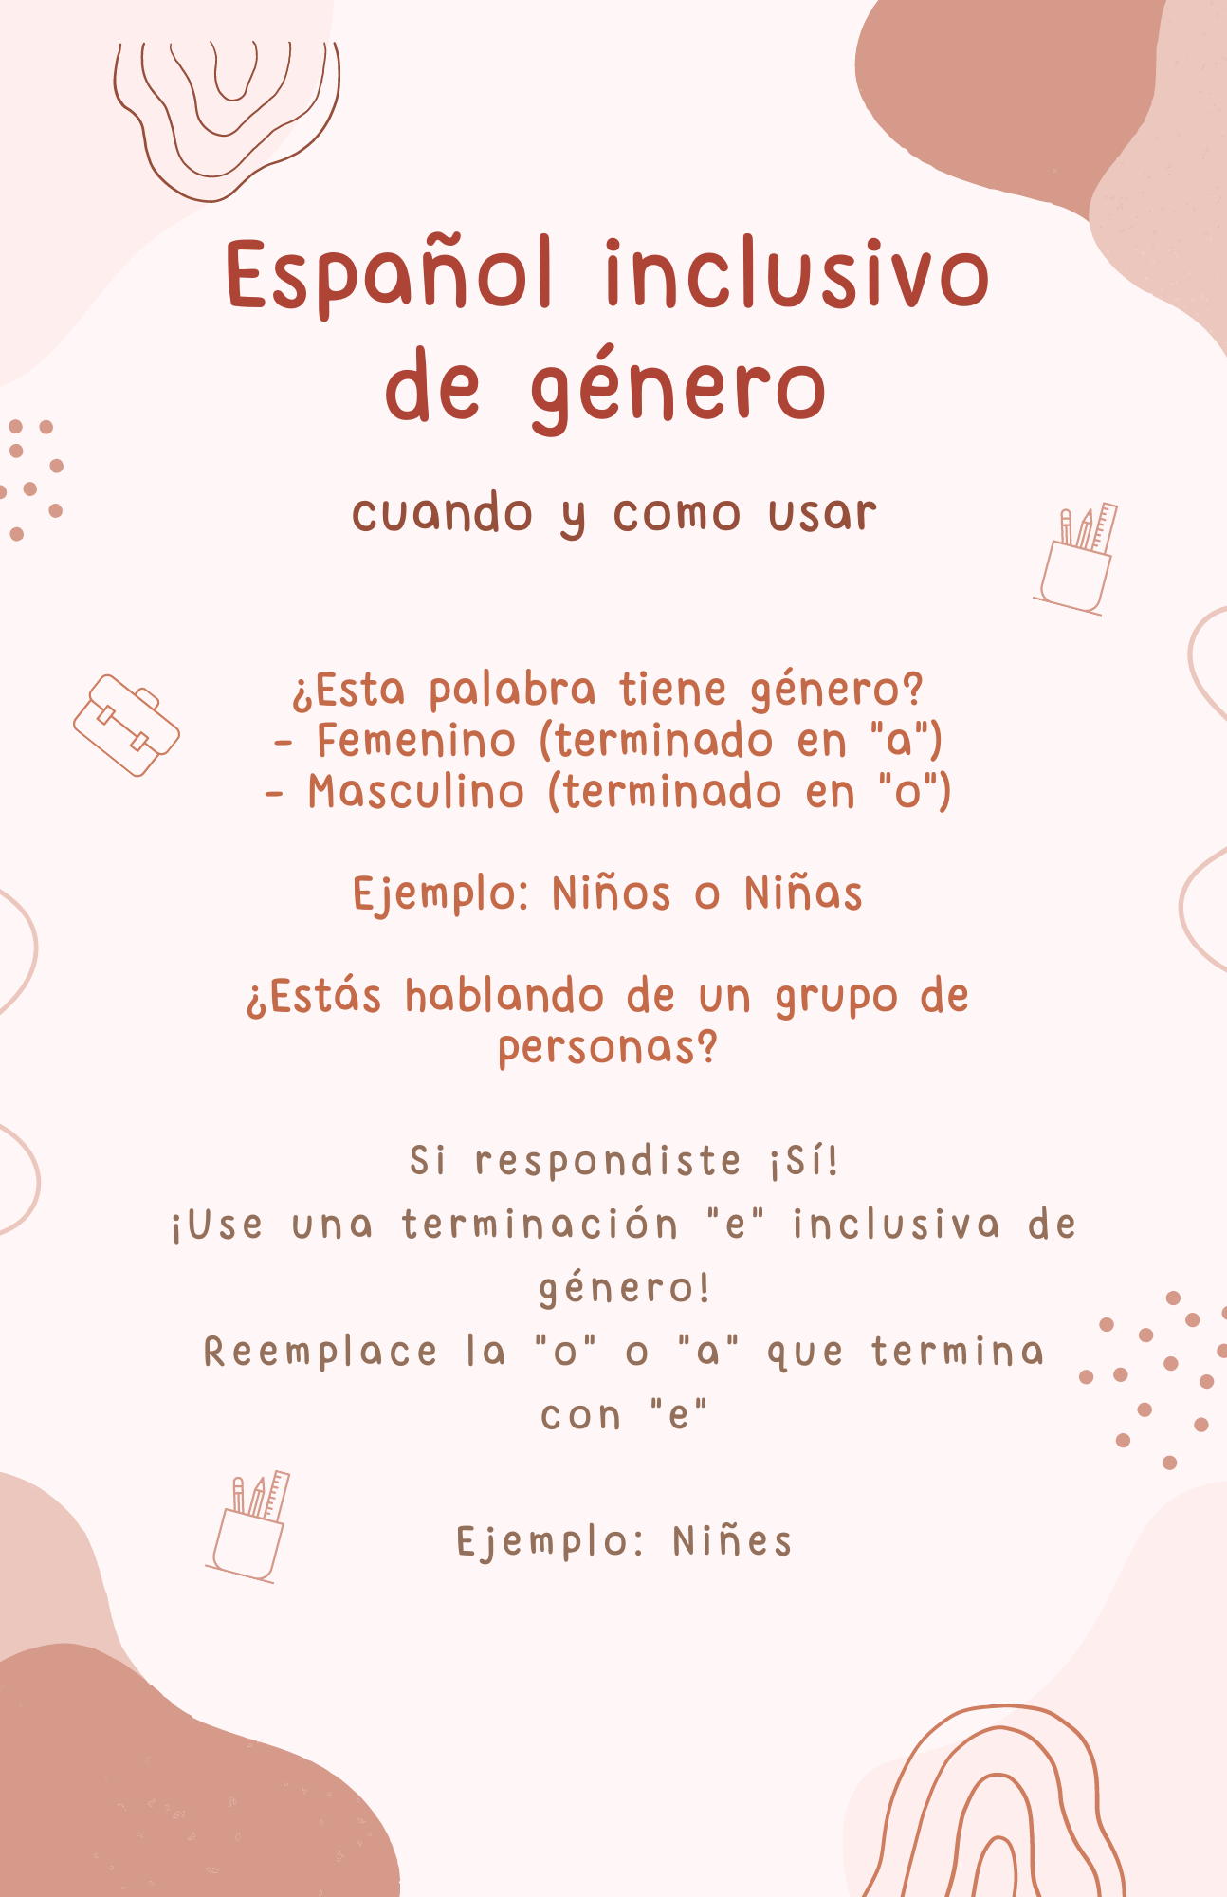

Slide 18
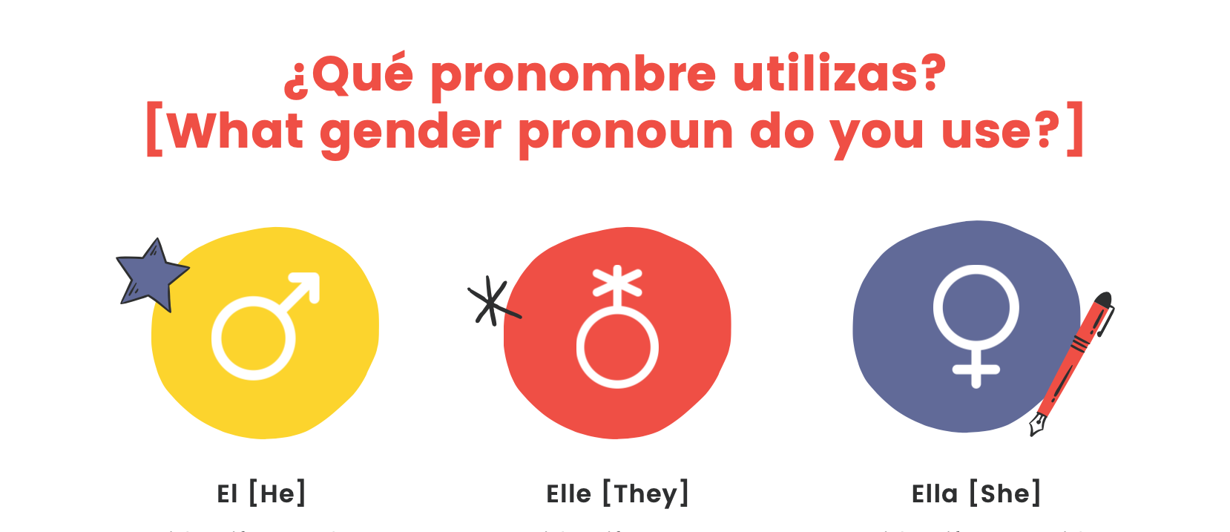

Slide 19
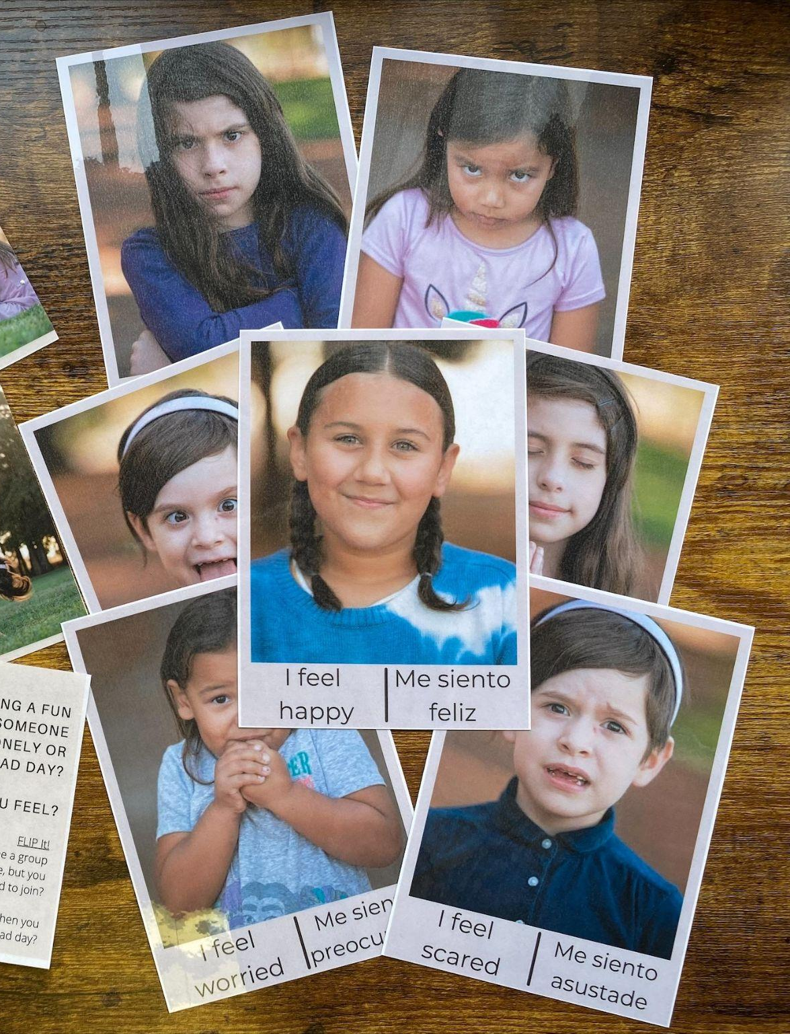
Talking about Feelings
Feelings cards included in Rainbow Kit
Options:
Asustado/a/e

Slide 20
Gender Inclusion in the Classroom
En lugar de decir “Niños” y “Niñas”
Dirijase a sus estudiantes con:
Todes
Estudiantes
Amigues
Nombre Del Salon (Por ejemplo las Mariposas)
Haga Grupos Usando:
Las Mesas
Sabor de helado favorito (Chocolate o Vainilla)
Color de Ropa
Notes:
Fern
LIlea

Slide 21
Practice using elle and -e endings
■Quinn es no binario y tiene un género que no es ni masculino ni femenino. Quinn usa el pronombre elle
■“Elle va a venir a mi fiesta de cumpleaños mañana”
■“Le invité a elle venir a mi fiesta de cumpleaños”
■“¡Todes pensaron que mi pastel de cumpleaños era delicioso!
■“Como se llama tu maestre?”
■“¿Tienes hermanes?”
■Todes son bienvenides aquí
■”¡Yo tengo un montón de amigues!”
Notes:
Fern
Lilea

Slide 22
Translation and Interpretation:
Best Practices
For presenter: talk slow, take breaks
Introducing use of e/x when talking about people
Inclusive Practice
Notes:
Fern

Slide 23
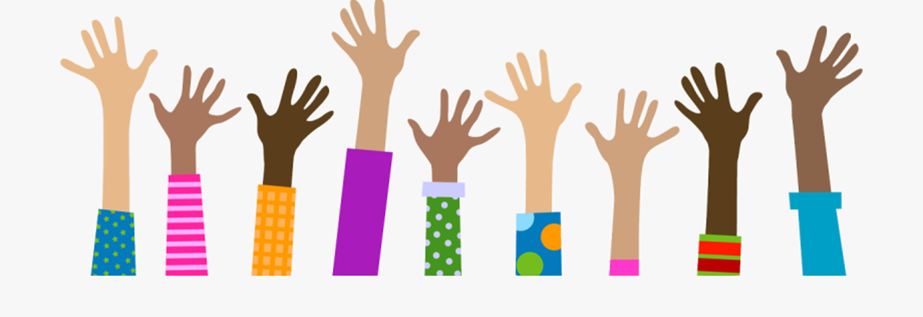
Questions? - ¿Preguntas?

