Slide 1

Quarterly Convening
February 4, 2020
1:30 pm-4:30 pm

Slide 2
We would like to begin today by acknowledging that we
gather as Live Healthy Napa County on the ancestral and
unceded territory of the Patwin, Onosatis, Miwok and Pomo Peoples past and present, and honor with gratitude the land itself and the people who have stewarded it throughout the
generations.

Slide 3
Welcome and Introductions
Please tell us:
Your name
Your organization (if applicable))

Slide 4
Agenda
Updates from stakeholder groups
Grants/CHIP update
Action Plan Launch
Human-Centered Design
Close
Notes:
Lens – community member engaging with CHIP

Slide 5
Updates from other community groups
working on health equity

Slide 6
Grants
Strong Systems, Strong Communities (SSSC)
  Technical assistance to conduct an equity action lab
Cross-sector Innovation Initiative (CSII)
  $150,000 over two years
Notes:
JH

Slide 7





Aligned through Design
Improving health equity in Napa County through shared data and human-centered strategies
Notes:
JH

Slide 8
CSII Grant Objectives
We have shared priority of addressing health inequities through increasing respect and social inclusion in our community.
Our project expands the use of human-centered design as a tool for engaging community in the planning and implementation of solutions to health-related challenges.
We seek to align outcomes, data and measurement across sectors, with a specific focus on the qualitative data captured through the use of human-centered design.
Notes:
JH

Slide 9
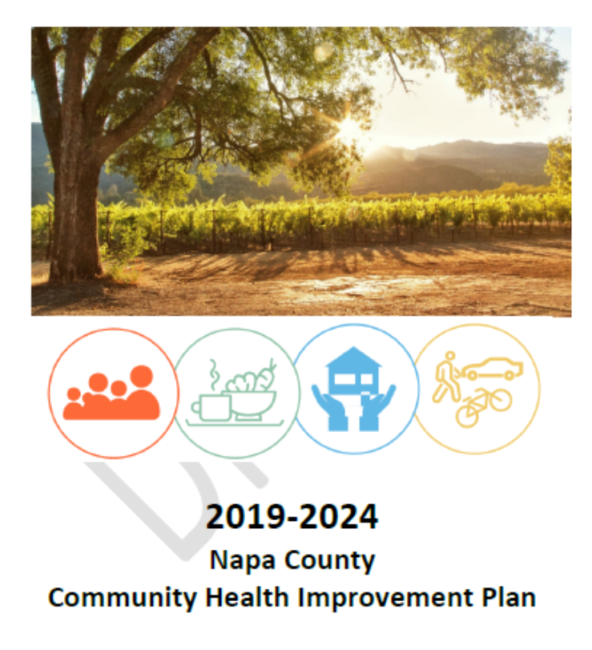
CHIP Update
CHIP
Update

Slide 10
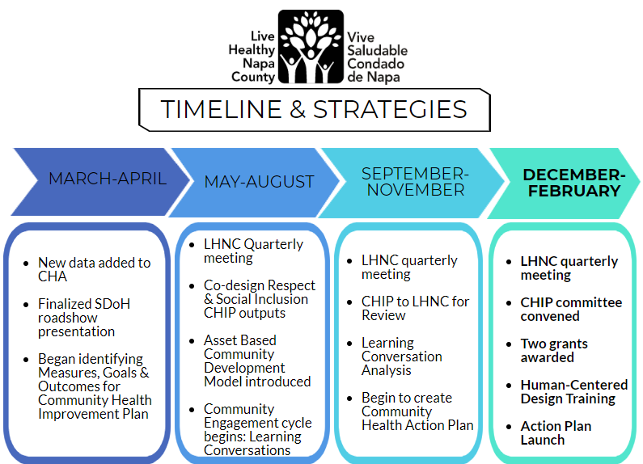
Notes:
EN

Slide 11
Community Health
Action
Plan
Notes:
EN

Slide 12
CHIP or CHAP?
A community health improvement plan is a strategic plan, while a community health action plan is an implementation plan.
A community health improvement plan describes the why and what, while a community health action plan describes the who, when and how.
Notes:
An action plan should show how we will implement strategies to obtain objectives listed in our CHIP. We develop an action plan so we can track details, check for feasibility, increase efficiency and ensure accountability. It’s also a way to articulate our plans clearly to outside partners and potential funders. We should just think about this as our workplan.

Slide 13
Contents of an action plan
What action or change will occur?
Who will carry it out?
By when (for how long)?
What resources are needed?
Communication (who should know what?)
Notes:
EN

Slide 14
Action Plan Example:
Reducing the Risk Coalition in Lee County:
One community change sought by this coalition to prevent teen pregnancy was to increase publicity about contraception and unwanted pregnancy at
the local high school.
What action or change will occur: Hanging posters, displays, and other
information about contraception and the facts about unwanted pregnancy
in the hallways of the local high school. The posters and other information will become a permanent part of the high school. Posters and information
will be regularly changed as new materials become available.

Slide 15
Action Plan Example:
Who will carry it out: A sub-committee comprised of parents and guardians, teachers, students, and coalition members will be responsible for maintaining the displays. The coalition as a whole will work towards finding funding to purchase the materials. Maria and Alex of the schools
action group will be responsible for researching and ordering the materials.
By when will it take place, and for how long: The coalition will try to have posters hanging and displays visible within six weeks of deciding on the action step What resources are needed to
carry out the step: The coalition will approach the school district to request funding for the
project. Otherwise, the group will seek funding from other sources such as foundations and
local businesses to finance the program.
Communication about the action step. The school principal and leadership of the Parent-
Teacher Organization (PTO) should be given information about this planned change.

Slide 16
Tiered Approach
Our goal today is design for activities or actions. While we want to address all of the assets and ideas in the room, we want to focus on feasibility first.
We want our action plan to be a living document that we can add to over time. This means we would like to start with no more than 4 initial actions
Notes:
EN

Slide 17

Please be back in
15 minutes

Slide 18
Human-Centered Design
Discover the opportunity
Empathize
Ideate
Define
Prototype
Test
Understand
people deeply
Experiment your
way forward

Slide 20
Learning Conversations with community members May – November 2019
August and November LHNC meetings – unpack and infer insights

Slide 23
What are people’s motivations, beliefs, and behaviors?
What do we aim to do with our community?
INSIGHTS
OPPORTUNITIES
UNPACK
& INFER
POSE HMW QUESTIONS
What interventions should we create?
What are people’s experiences?
INTERVIEW
PROTOTYPE
DATA
SOLUTIONS
Notes:
Can enter this cycle from different phases and could also go backward (e.g. revise HMW questions after getting feedback on prototype). One thing emphasized by Stanford was that a prototype is not a pilot. A prototype is meant to test assumptions.

Slide 24
I don’t know where we’re going, but I know we will get there!
Notes:
This might feel messy or confusing and that is OK.

Slide 25
GUIDING STAR
All residents feel
respected and
included
in Napa County

Slide 26
Ideation/Creation Expedition
Notes:
We generate “HMW questions” based on the learning conversation data, as well as your notes from your OST groups.
It is our task today to use those questions to brainstorm to generate ideas that address those questions. We will get into groups to choose a question we’d like to work on.
Then, and this is the difficult part, each group will select one idea that they would like our collective to consider as part of our action plan. As we said earlier, we’d like have 4 or less actions to focus on, so we will send out a survey after this meeting, asking folks to select their top 4.
We may or may not get to the last step today, which asks each group to generate the details of their idea, and how we might test it. Before the next LHNC meeting in May, I will reach out to people with an opportunity to further flesh out each action item. This is where we might prototype, do more ethnography, or test assumptions (all part of the design process). I would also like to include residents who are impacted by the issue at hand to these design meetings.
But back to today: I’m going to briefly talk about set some design rules before we run a mini design exercise to get us in the right mindframe.

Slide 27
Hold an attitude of ...
YES, AND!
Defer judgment.
Go for quantity.
Build on ideas (of others).

Slide 28
For group brainstorming ...
SAY IT WRITE IT STICK IT
One conversation at a time.
Headline!
Capture all ideas.

Slide 29

MINI DESIGN CHALLENGE:
Take 2 minutes to
redesign a carry-on suitcase
Notes:
constrain solution space

Slide 30
MINI DESIGN CHALLENGE:
Take 2 minutes to
redesign a way to get what you need when you reach your travel
destination
Notes:
constrain problem space, open solution space

Slide 31
Ideation/Creation
Expedition
Get into groups of 5-6 people
Choose a “How Might We” question
Brainstorm on your own first
Say it, Write it, Stick it!
1
2
3
4
Notes:
Ground rules:
No judgement, big and small ideas are all accepted here!
You say, you write it, you stick it
Save your editing eye for after ideation
Quantity over quality in this stage

Slide 32
PLEASE MAKE SURE THAT YOU:
Sign in, with your email address
Put your name on your group’s flipchart
Complete short Design Survey

Slide 33
Closing
We will:
    Share meeting outcomes through email and website:
http://www.livehealthynapacounty.org/
    Next LHNC meeting is May 5, 2020
    Send out a survey to determine action priorities.
THANK YOU for participating!

Slide 34

Questions?

